Slide 1
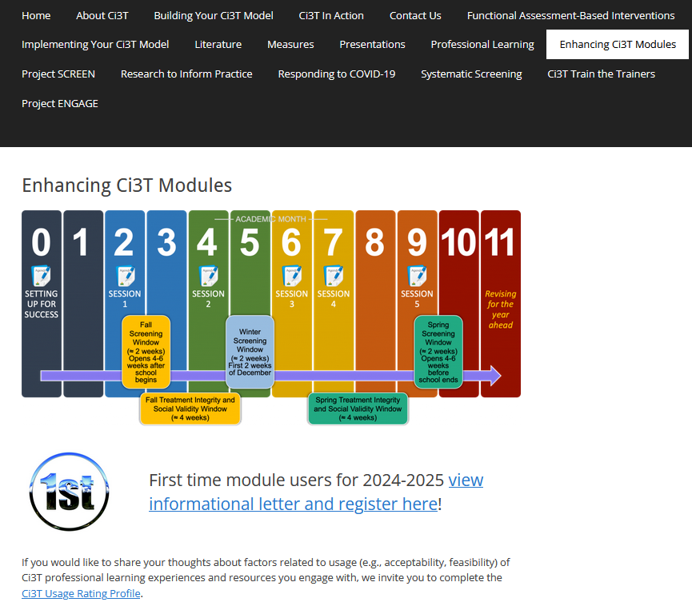
A Tier 2 Support for Students Experiencing Anxious Feelings: Recognize. Relax. Record.
Allison M. Bernard, Amy Buffington, & Elise Sarasin
University of Kansas
If you have not done so already, we invite you to visit ci3t.org/enhance to access modules after a one-time registration process!
This project was funded in part by Project EPIC (USDE, OSEP Award Number: H325D220011), Project ENGAGE (IES Project Number R324X220067 and Project ENHANCE (IES Project Number R324N190002).

Slide 2
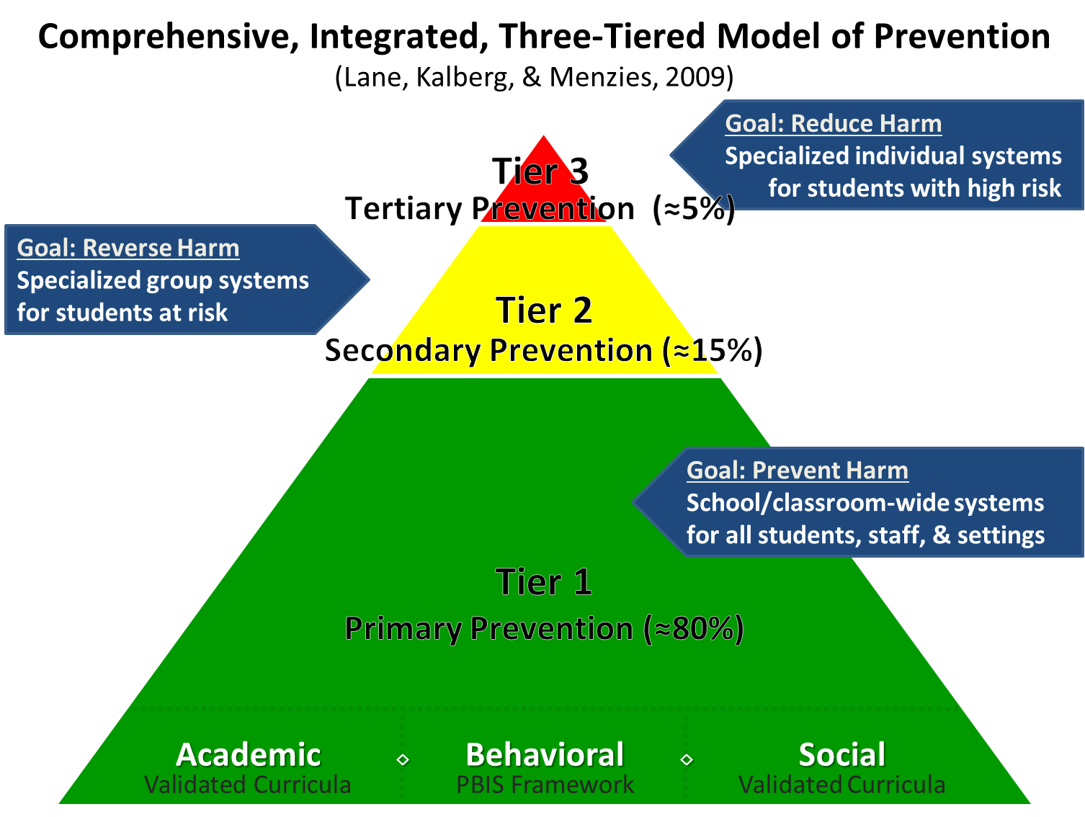
Comprehensive, Integrated, Three-Tiered Model of Prevention 1

Slide 3
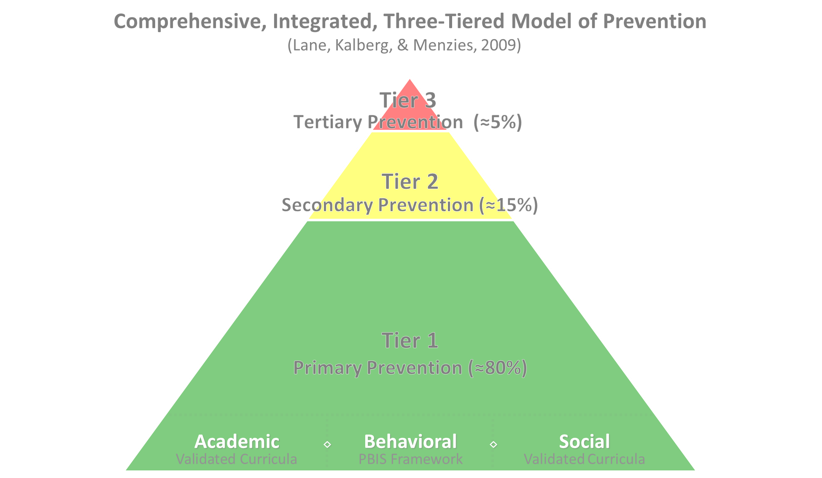

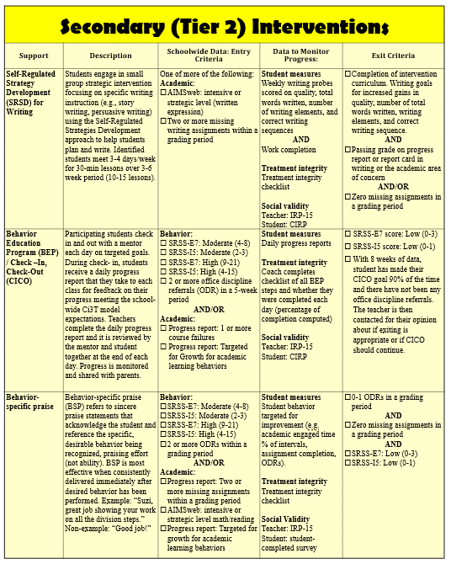
Secondary (Tier 2) Intervention Grid

Slide 4

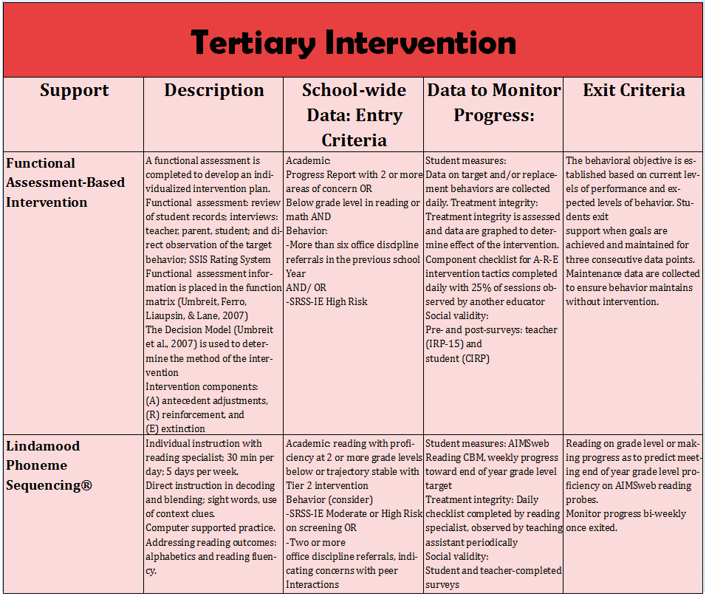
Tertiary (Tier 3) Intervention Grid

Slide 5
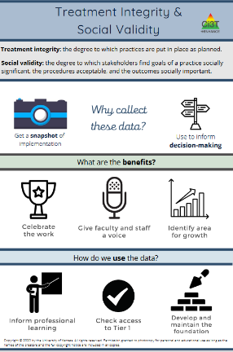
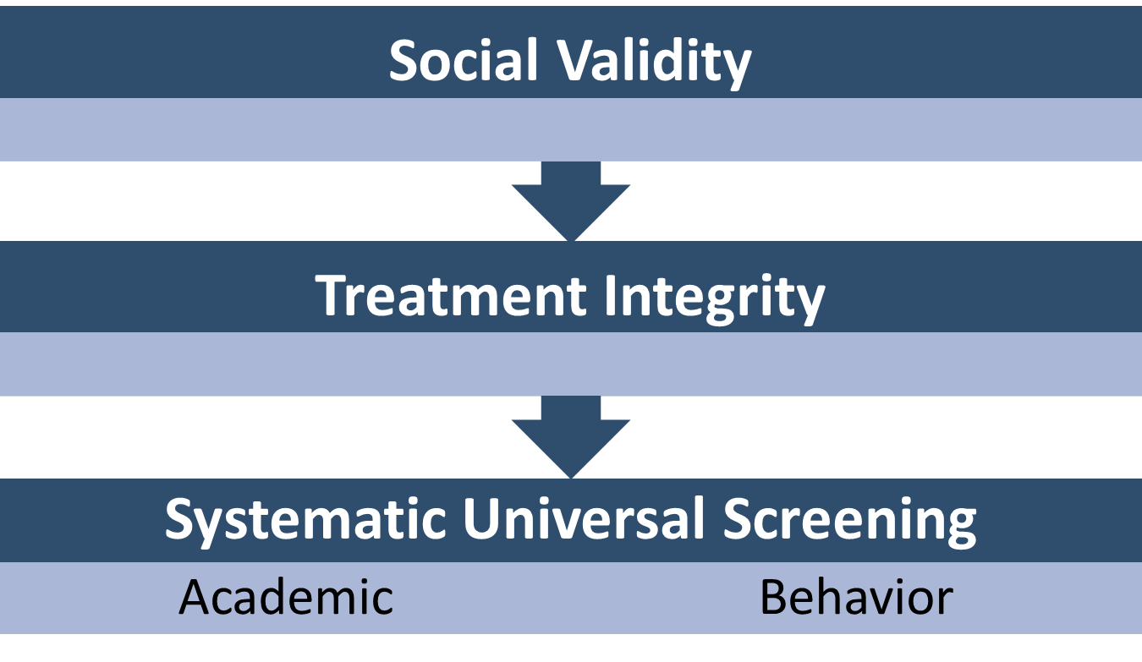
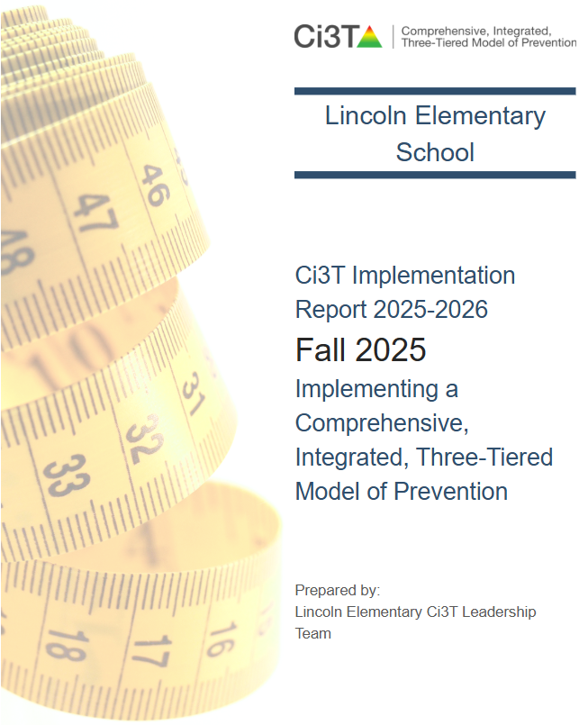
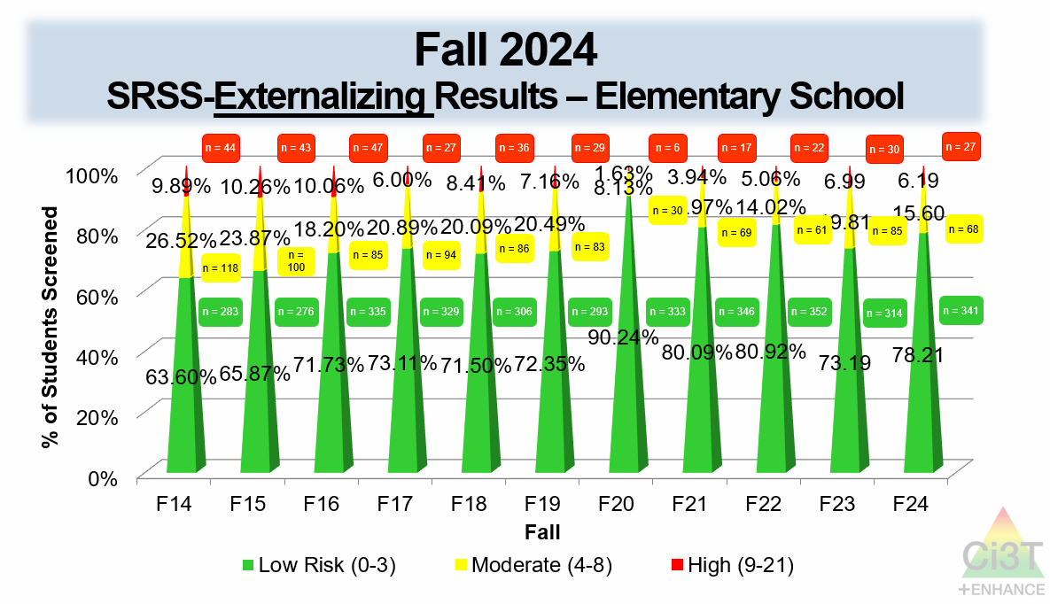
Essential Components of Primary (Tier 1) Prevention Efforts

Slide 6


Enhancing Ci3T Modules
ci3t.org/enhance

Slide 7
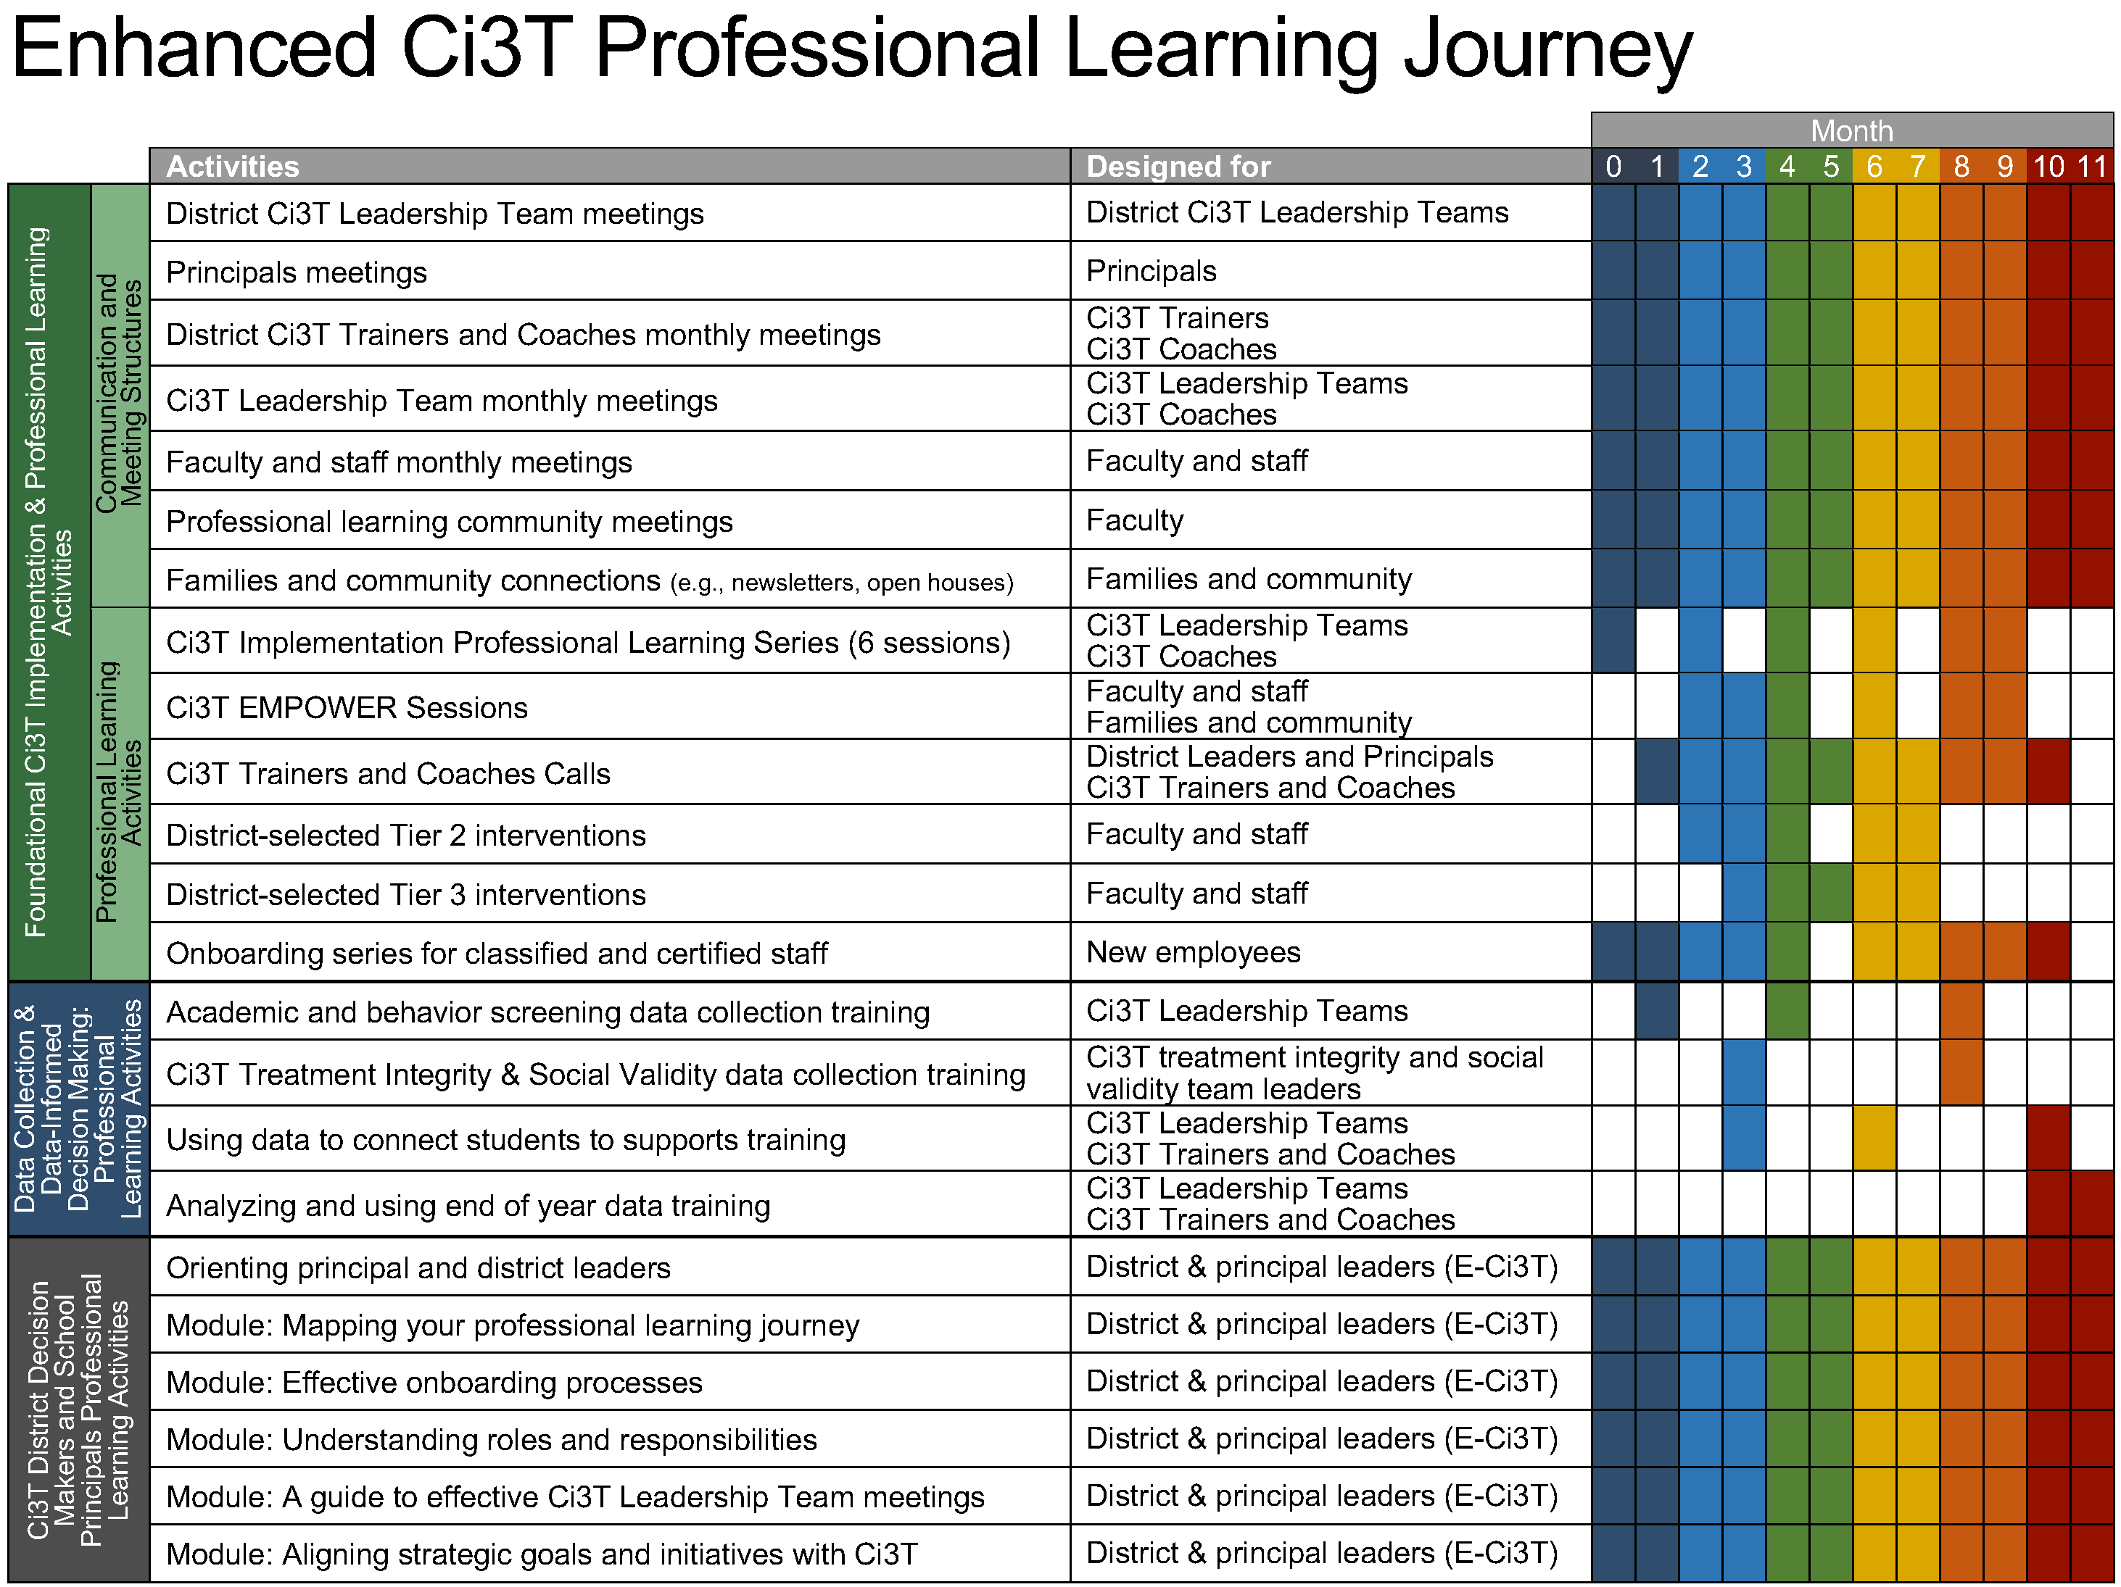
Session Outcomes
Explain how to review school-wide data to determine which students might benefit from this Tier 2 intervention.
Describe three key components of Recognize. Relax. Record.
Describe how to implement Recognize. Relax. Record. in a classroom setting.
Explain how to measure (a) implementation (treatment integrity), (b) users’ views of goals, procedures, and outcomes (social validity), and (c) student behavior (e.g., engagement, anxious feelings).

Slide 8
Agenda
Welcome
Situating Secondary (Tier 2) Interventions in Ci3T Models
Recognize. Relax. Record.
Introduction to Recognize. Relax. Record.
A Step-by-Step Guide to Implementation
Wrapping Up and Moving Forward

Slide 9
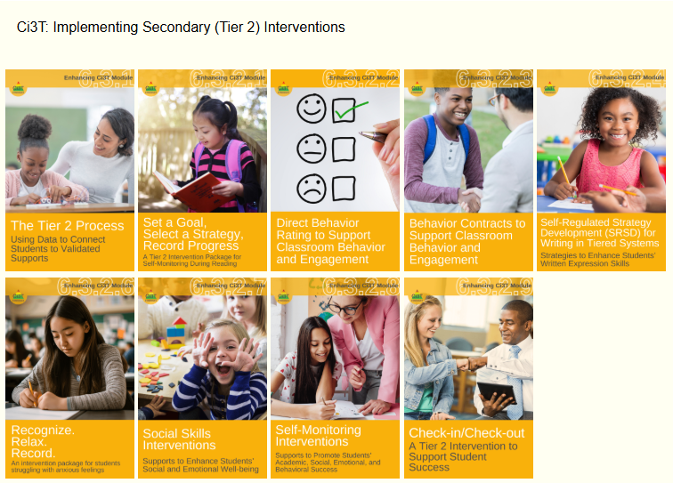
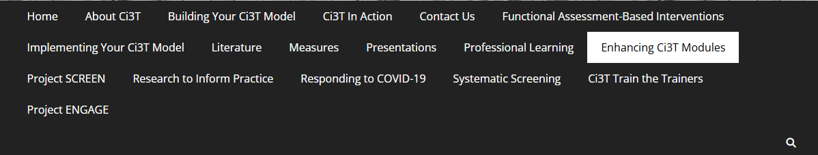
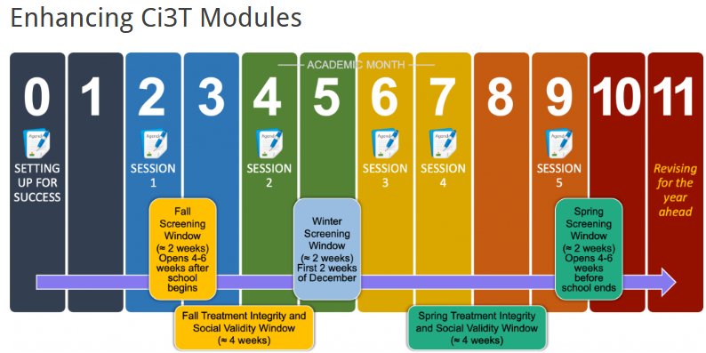
Accessing Professional Learning Materials
ci3t.org/enhance

Slide 10


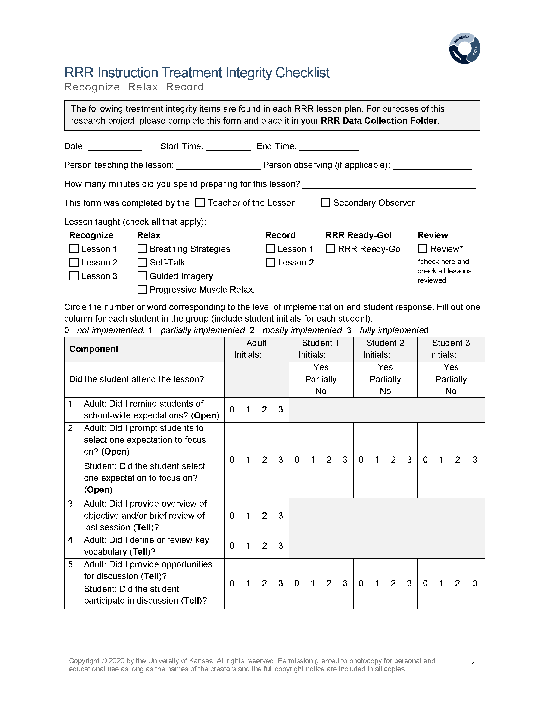
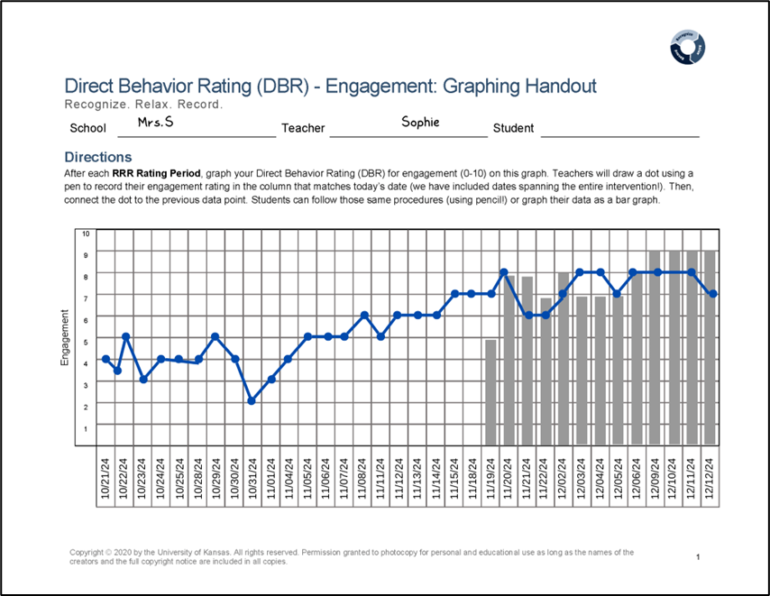
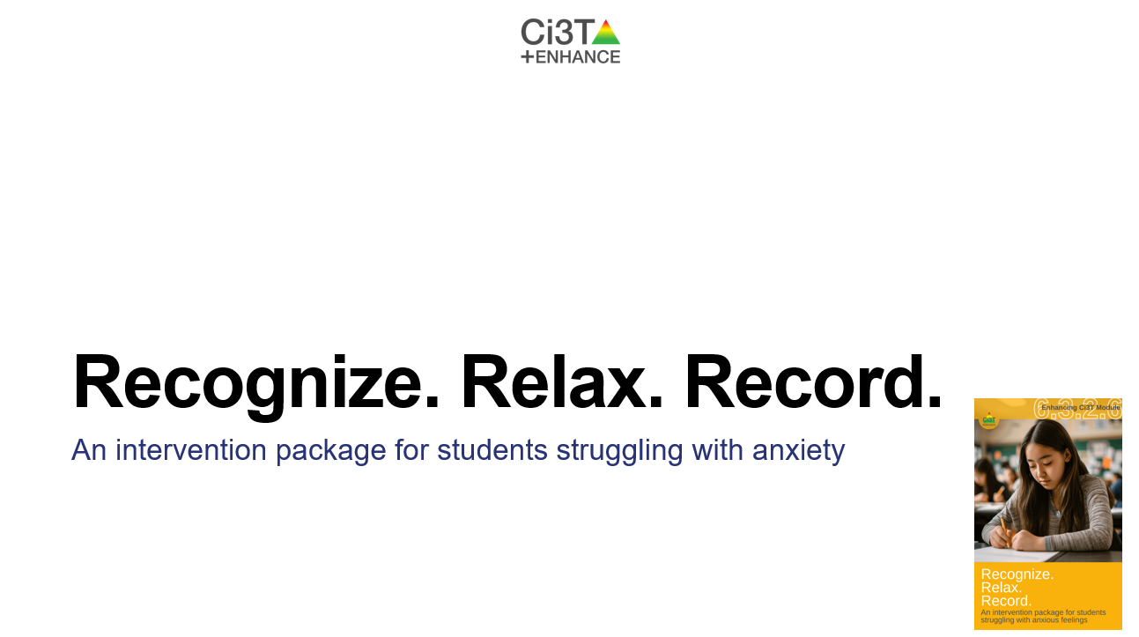
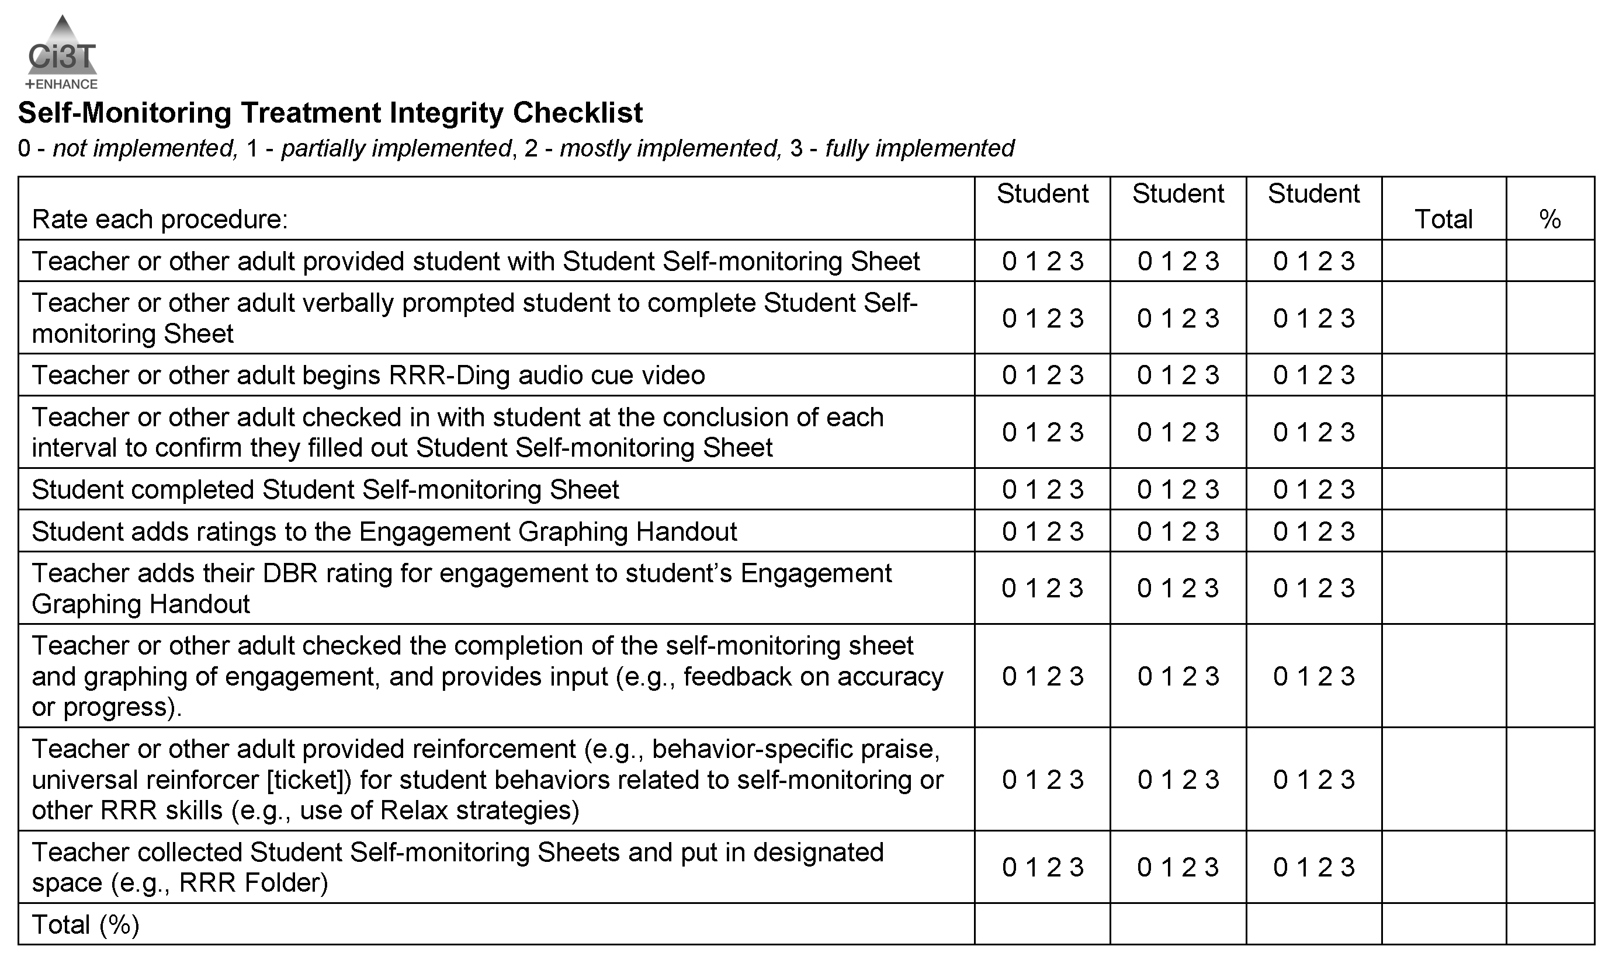
Knowledge, Application, Impact Points
Knowledge, Application, Impact Points 1
If you are in Kansas, you can earn 2 x PD points for application and 3 x for impact!
We are happy to review your materials before you upload!

Slide 11
Situating Secondary (Tier 2) Interventions in Ci3T Models

Slide 12
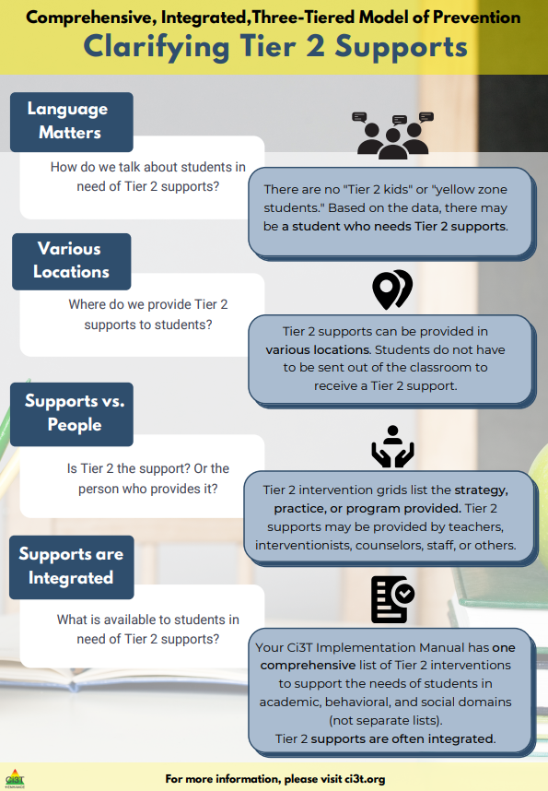
Clarifying Tier 2 Supports 1

Slide 13
Clarifying Tier 2 Supports 2

Slide 14
Clarifying Tier 2 Supports 3

Slide 15
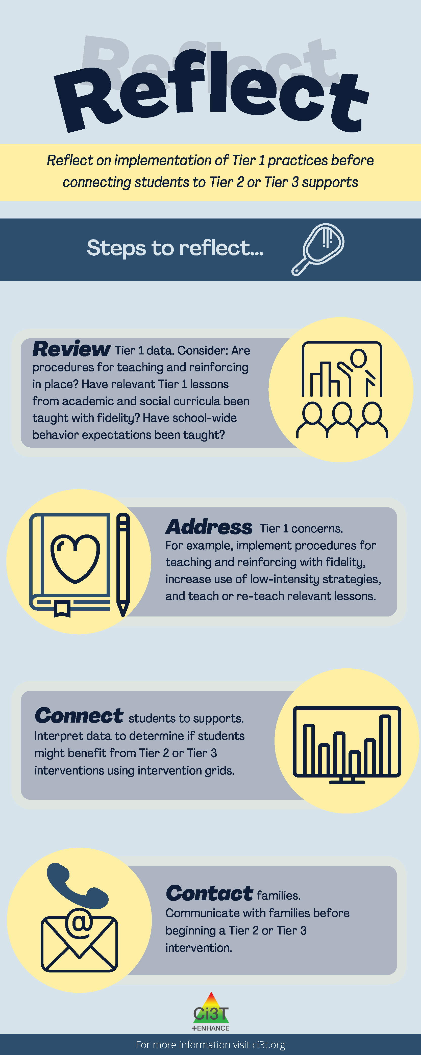
Reflect on Implementation of Tier 1 Practices

Slide 16
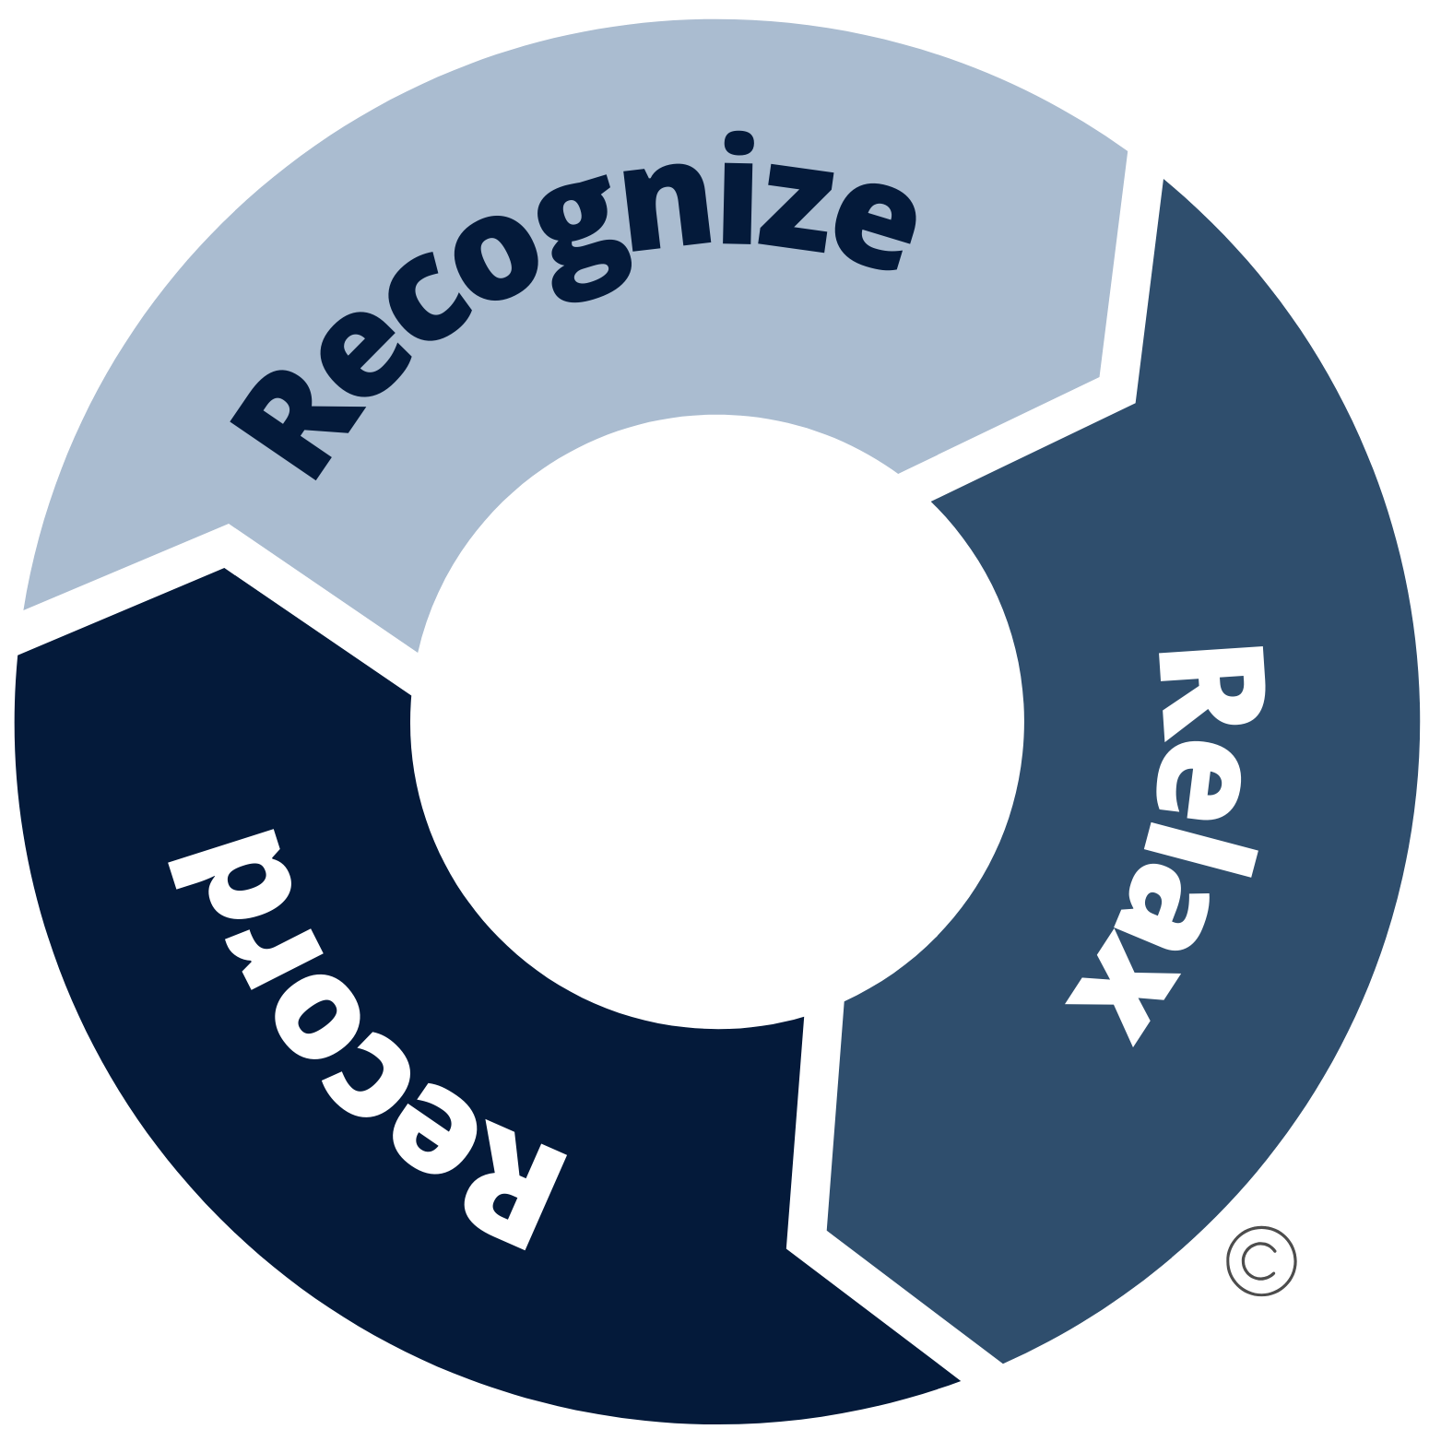
Comprehensive, Integrated, Three-Tiered Model of Prevention 3

Slide 17

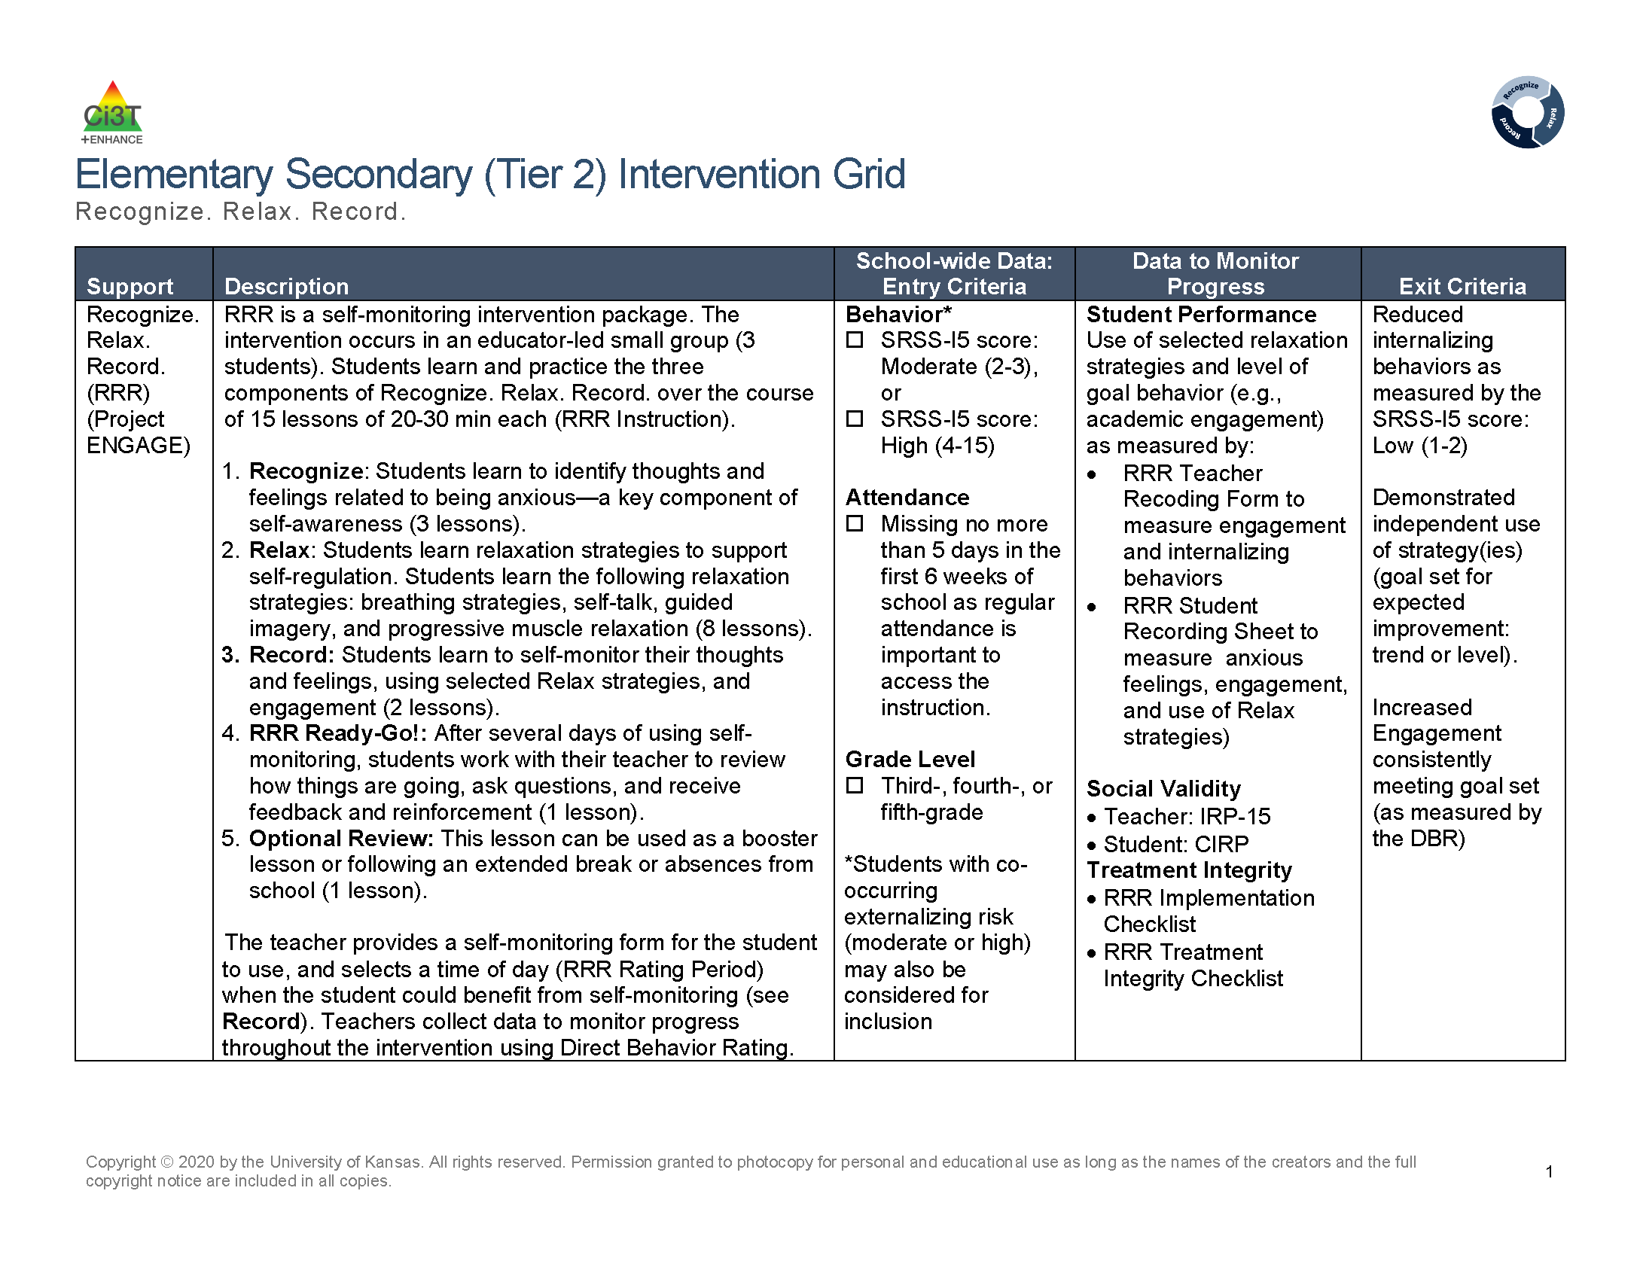
Recognize. Relax. Record. Secondary (Tier 2) Intervention Grid
Recognize. Relax. Record. Secondary (Tier 2) Intervention Grid 1

Slide 18

Expand and Explore
Let’s Chat 1
Which Tier 2 interventions are offered in your setting?

Slide 19
Recognize. Relax. Record.

Slide 20
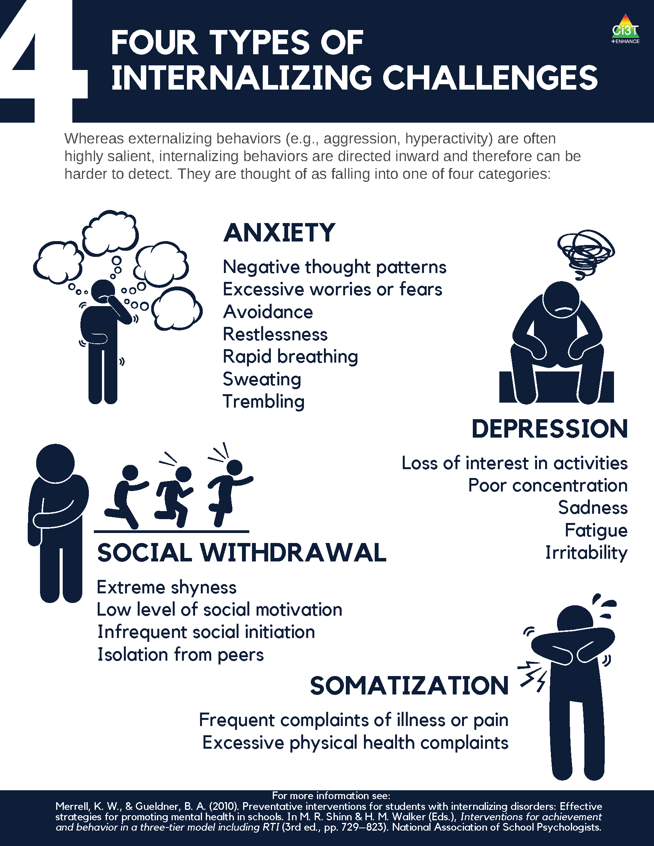
Four Types of Internalizing Challenges

Slide 21
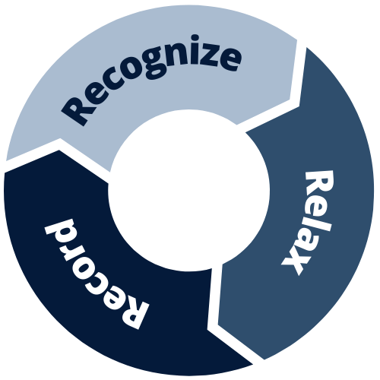
What is Recognize. Relax. Record.?
An intervention package containing three components:
Recognize
identify thoughts and feelings related to being anxious
Relax
manage anxious thoughts and feelings using relaxation strategies
Record
self-monitor thoughts and feelings, use of relaxation strategies, and engagement (social or academic)

Slide 22
What does the supporting research for Recognize. Relax. Record. say?
What Does the Supporting Research for Recognize. Relax. Record. Say? 1
Social-emotional competencies
Self-awareness
Self-management
Social awareness
Responsible decision-making
Relationship Skills
Recognize.
Social-emotional competencies, such as self-awareness and self-management, are related to important long-range outcomes
high school graduation
college degree completion
obtaining employment
Durlak et al., 2011
Adapted from CASEL Framework (2020)

Slide 23
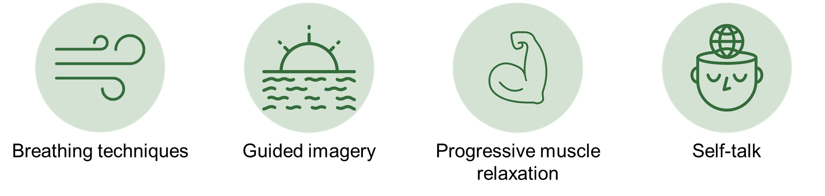
What does the supporting research for Recognize. Relax. Record. say?
What Does the Supporting Research for Recognize. Relax. Record. Say? 2
Relax.
Relaxation training is commonly used in research-based cognitive behavioral interventions for children with anxiety
Chorpita & Daleiden, 2009

Slide 24
What does the supporting research for Recognize. Relax. Record. say?
What Does the Supporting Research for Recognize. Relax. Record. Say? 3
Record
Self-management interventions effective for
behavioral and social outcomes
reading, math, and other content areas at elementary
Levendoski & Cartledge, 2000
productivity, engagement, and academic performance at middle and high school
Carr & Punzo, 1993
students with emotional and behavioral disorders
students educated in general and special education classrooms
A.M. Briesch & Briesch, 2016; Briesch & Chafouleas, 2009; Mooney et al., 2005

Slide 25
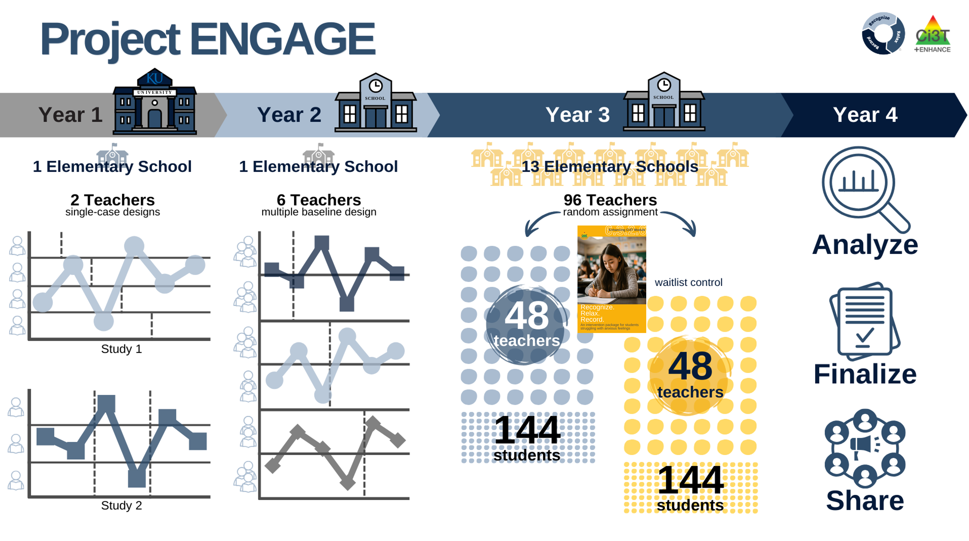
Project ENGAGE
A special thank you to teachers who participated! It was gift to learn from and with you!!!

Slide 26
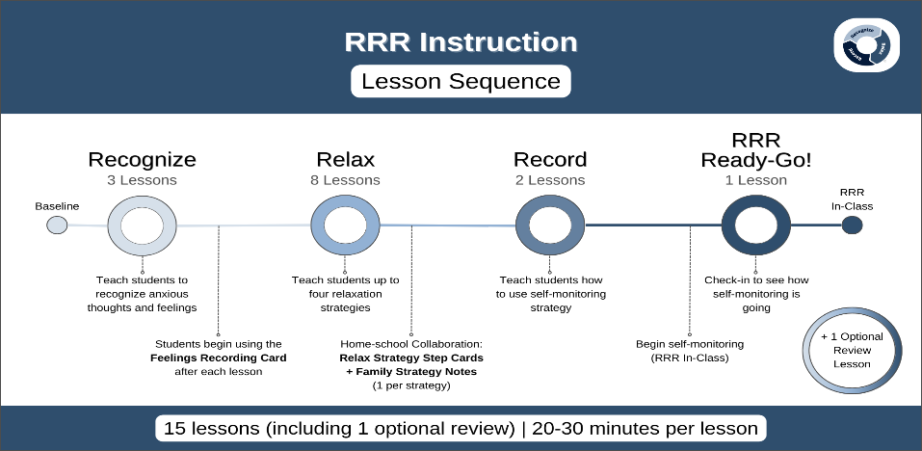
RRR Instruction Lesson Sequence

Slide 27
Baseline
This is the time (approximately two weeks) before beginning RRR instruction
Nothing else changes!
This allows for a comparison pre- & post-intervention
Direct Behavior Rating (DBR)
Goal is to collect ~6-8 data points

Slide 28
RRR Instruction
Deliver small group RRR Lessons
~20-30 minutes per lesson
Up to 15 lessons
Teacher-led small group (3-5 students)
Teachers continue to collect DBR

Slide 29
RRR In-Class
Continue to collect DBR data
Student Self-Monitoring
Teachers facilitate self-monitoring

Slide 30
Step 1
Use data to connect students to Recognize. Relax. Record

Slide 31
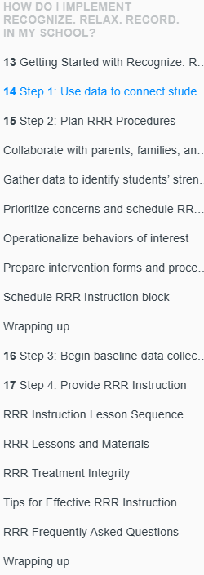

RRR Module Highlight!
RRR Module Highlight 1

Slide 32

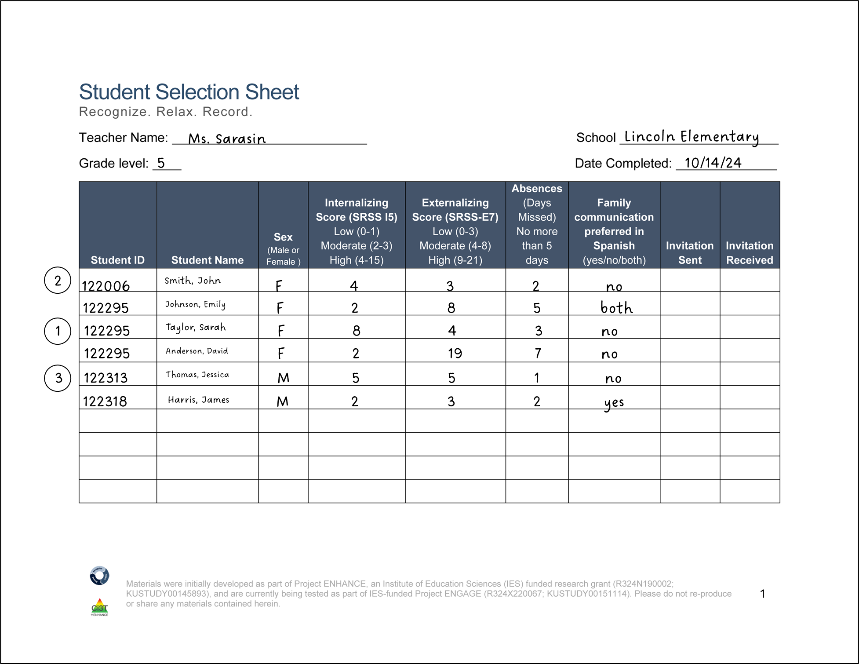
Step 1 Use data to connect students to Recognize. Relax. Record.
Screening

Slide 33
Step 2
Plan RRR Procedures

Slide 34
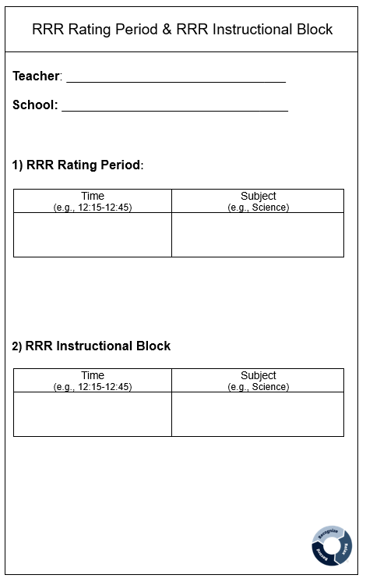
Step 2 Plan RRR Procedures
Step 2 Plan RRR Procedures 1
Collaborate with parents, families, and colleagues
Gather data to identify students’ strengths, abilities, and needs
Schedule
RRR Rating Period
Time when baseline (Direct Behavior Rating) data collected
Time when students will use self-monitoring during RRR In-Class phase
RRR Instruction Block
Time when small-group instruction will occur (15 lessons, 20-30 min each)
2:00-2:40
Monday-Thursday
Math
10:00-10:25
Monday, Wednesday, Thursday
Independent Work Time

Slide 35
Step 3
Begin baseline data collection

Slide 36
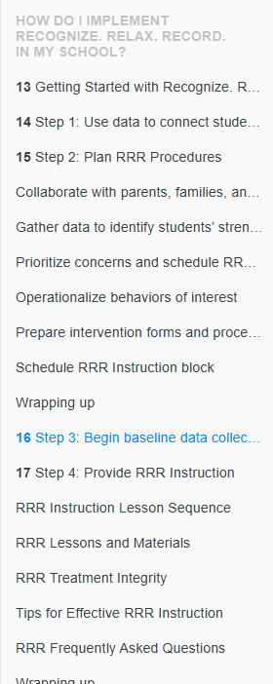
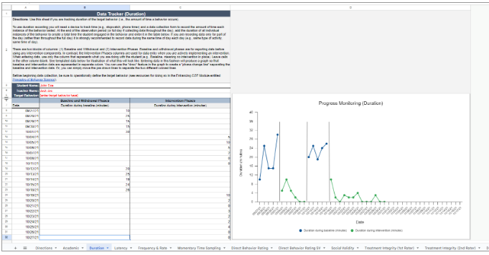
RRR Module Highlight!
RRR Module Highlight 2

Slide 37
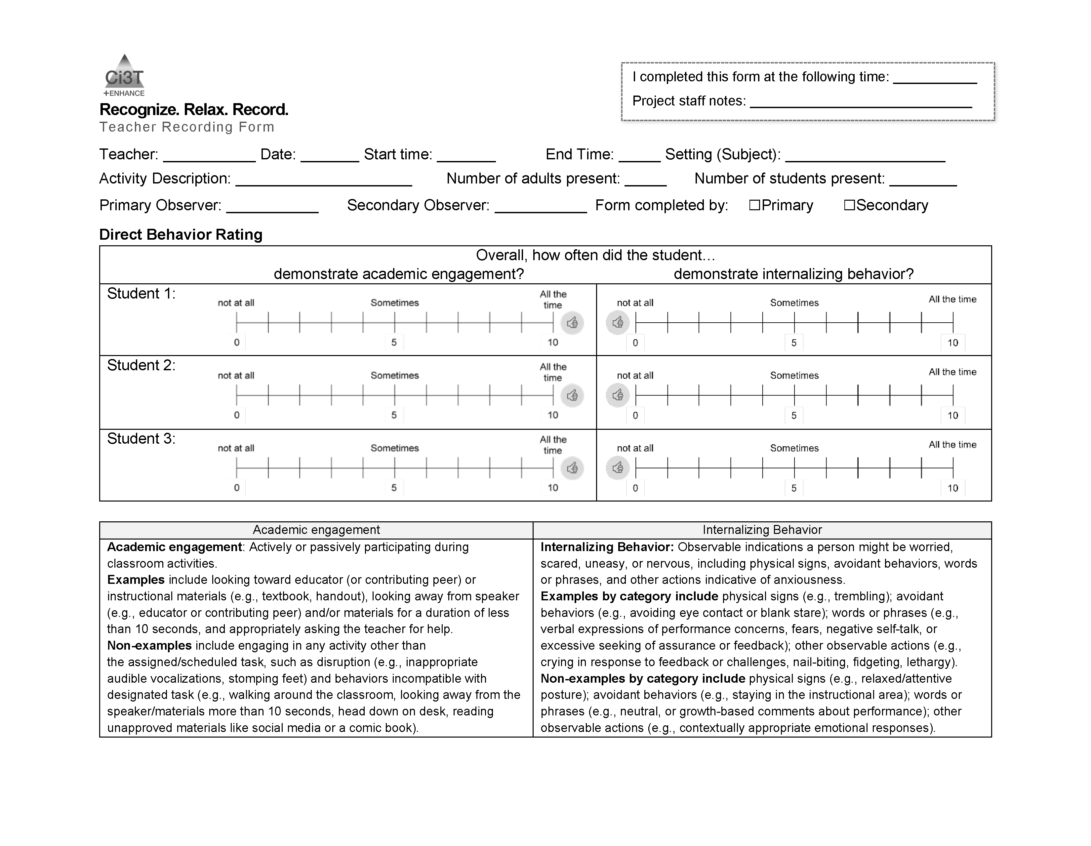
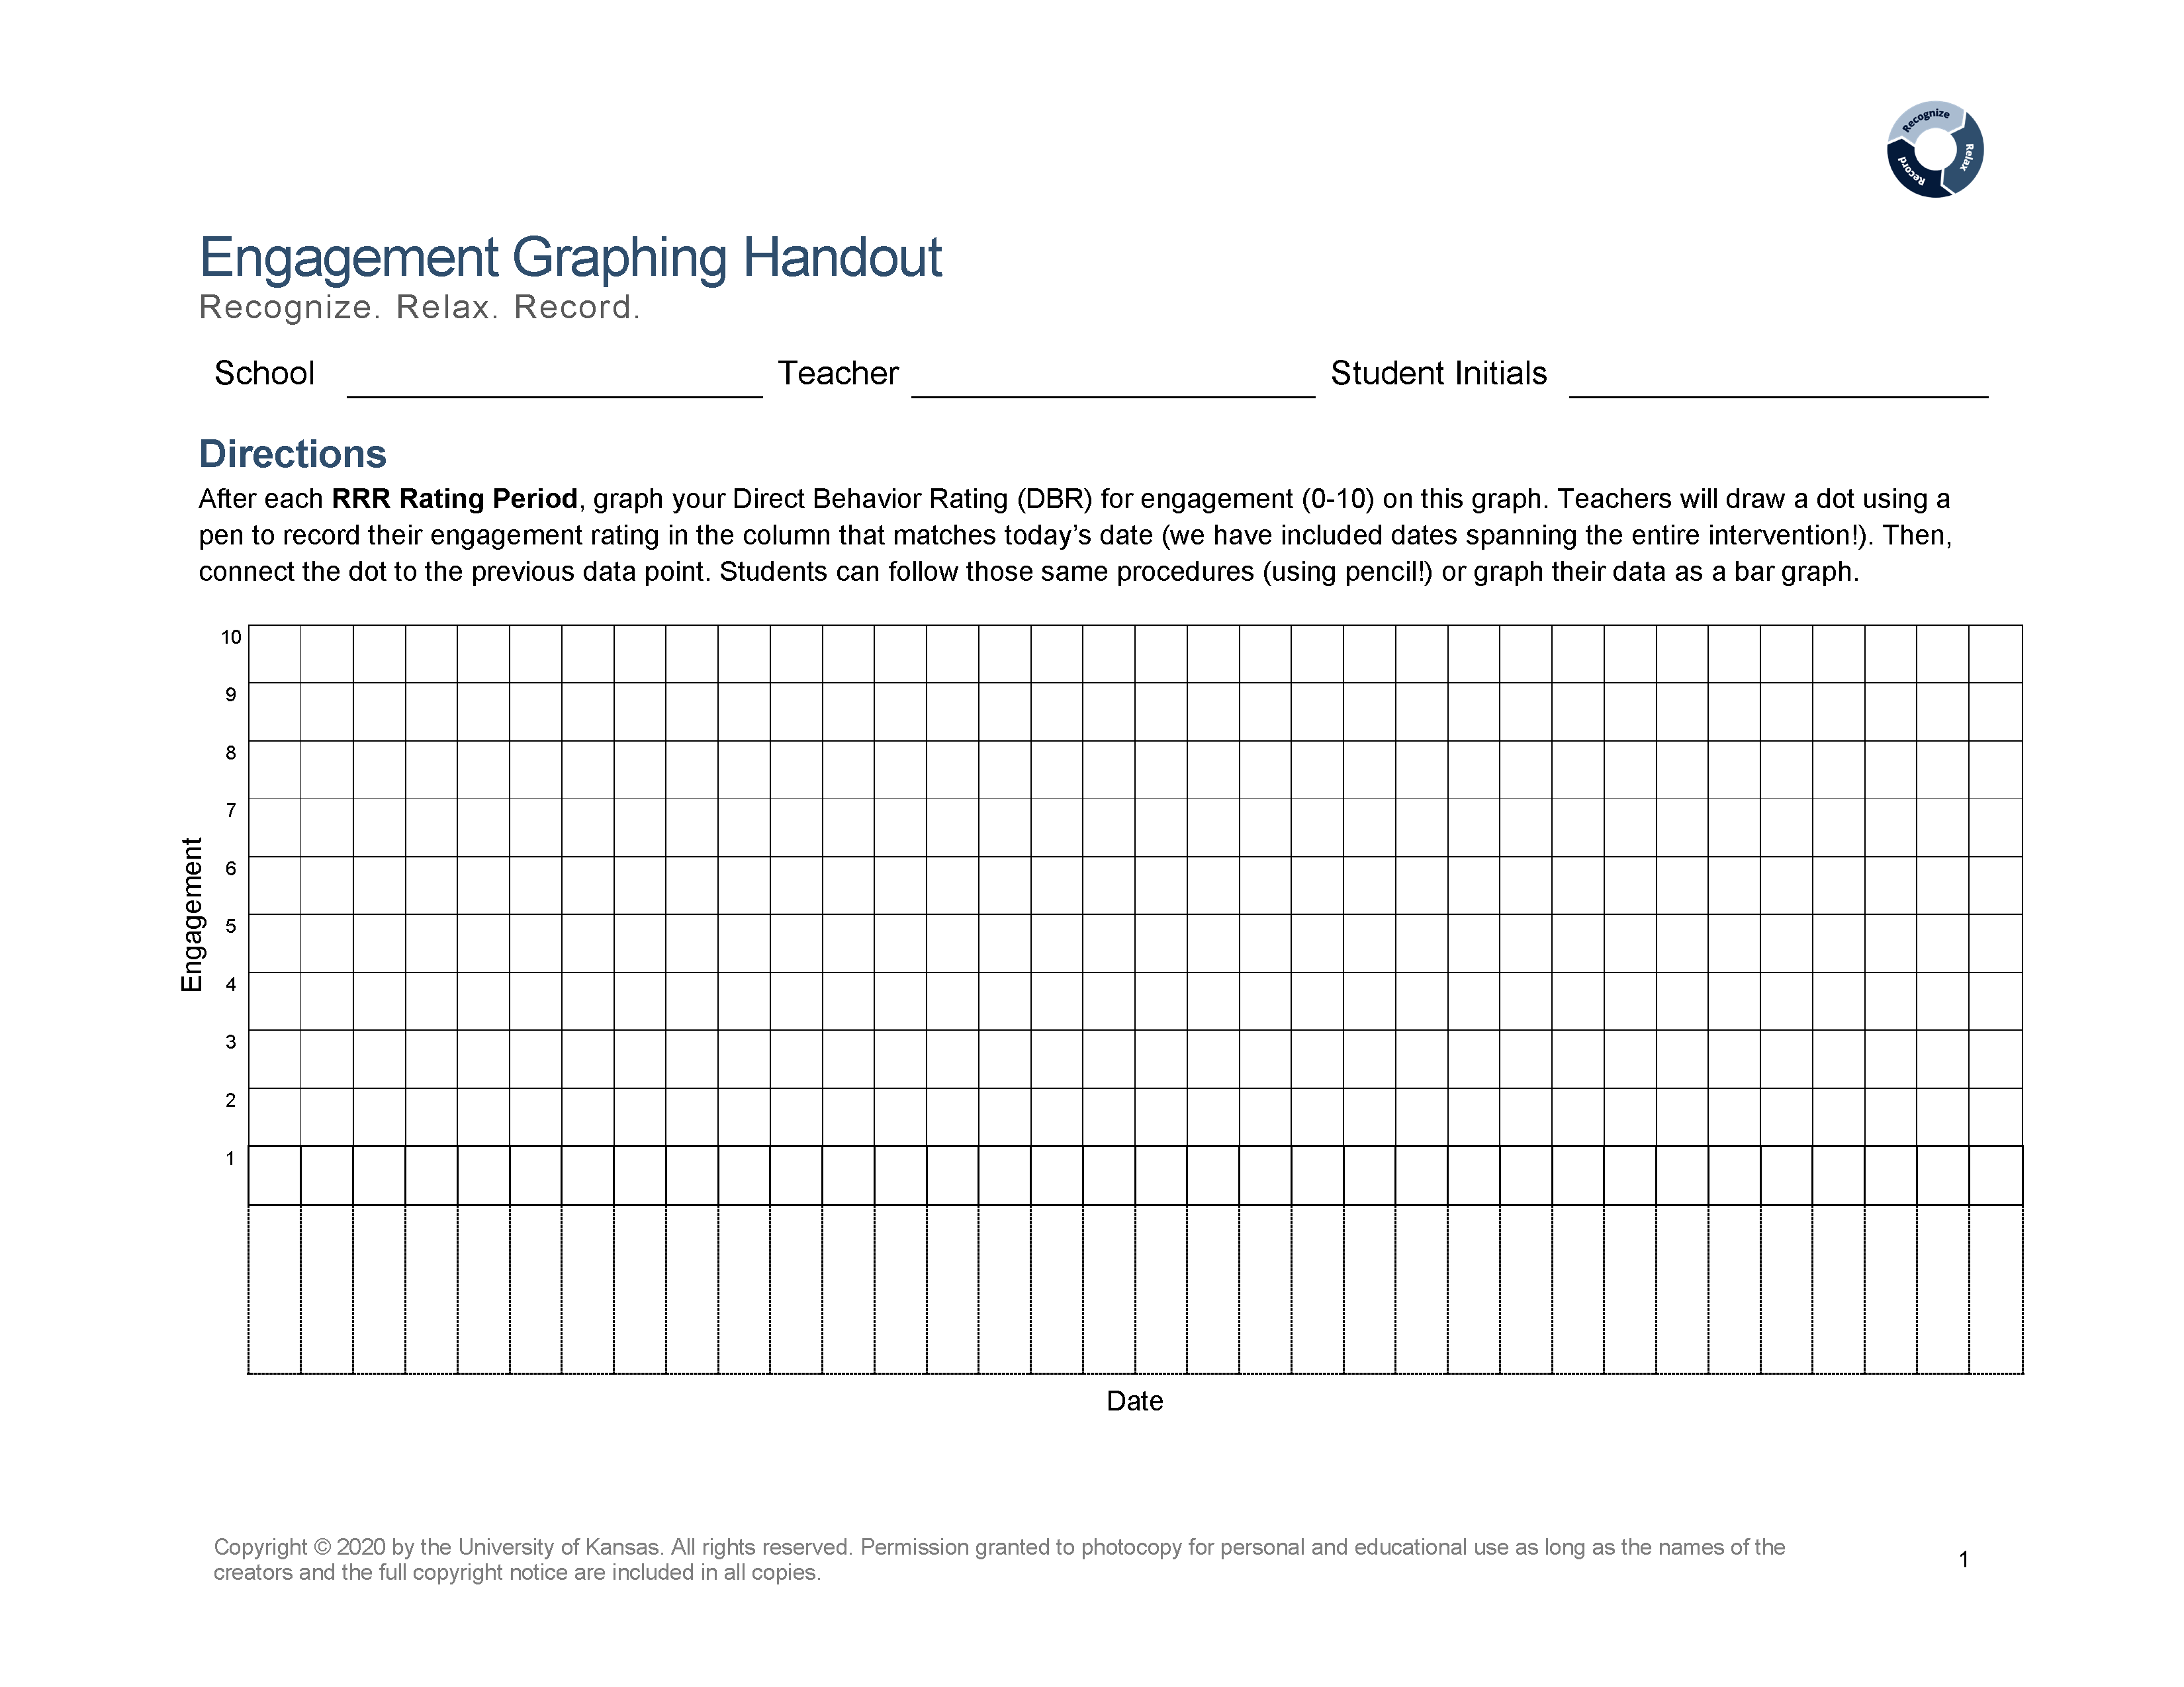
Step 3 Begin baseline data collection

Slide 38
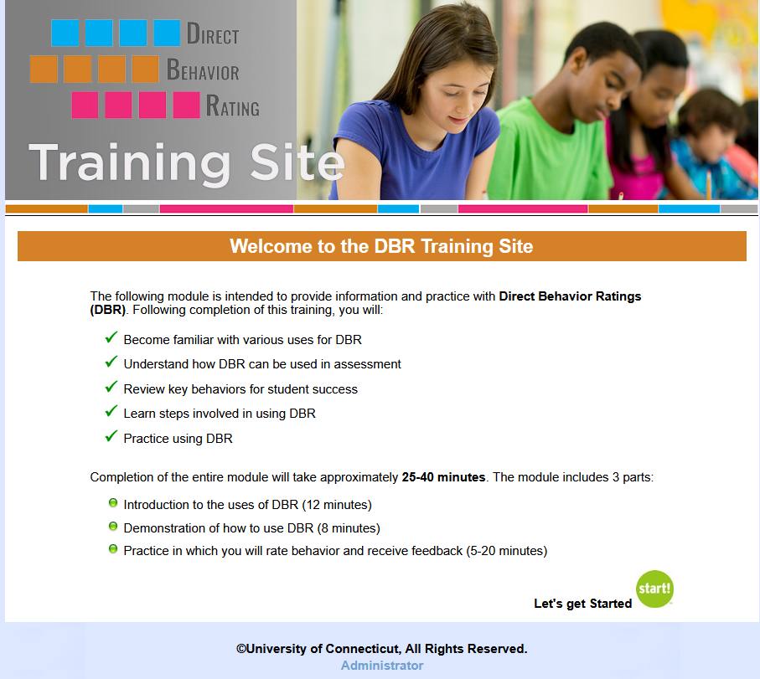
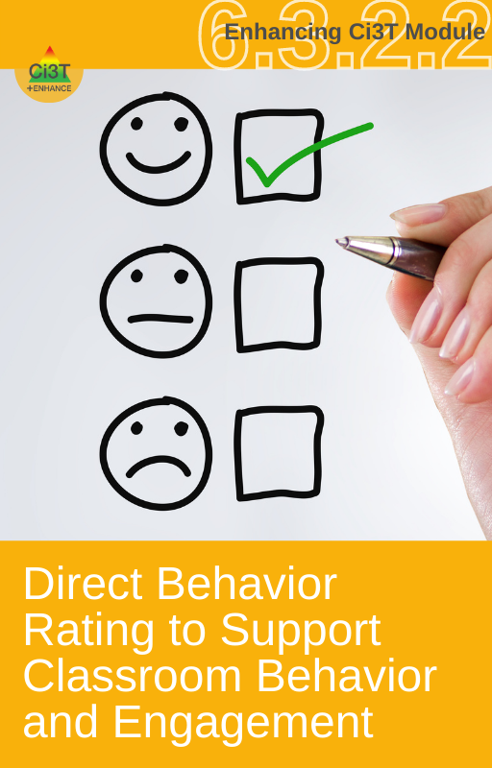
Direct Behavior Rating (DBR)
A tool that involves a brief rating of target behavior immediately following a specified observation period.
Source: University of Connecticut. (n.d.). Direct behavior rating: Assessment training module. [video training module].
www.dbrtraining.education.uconn.edu/video.php

Slide 39
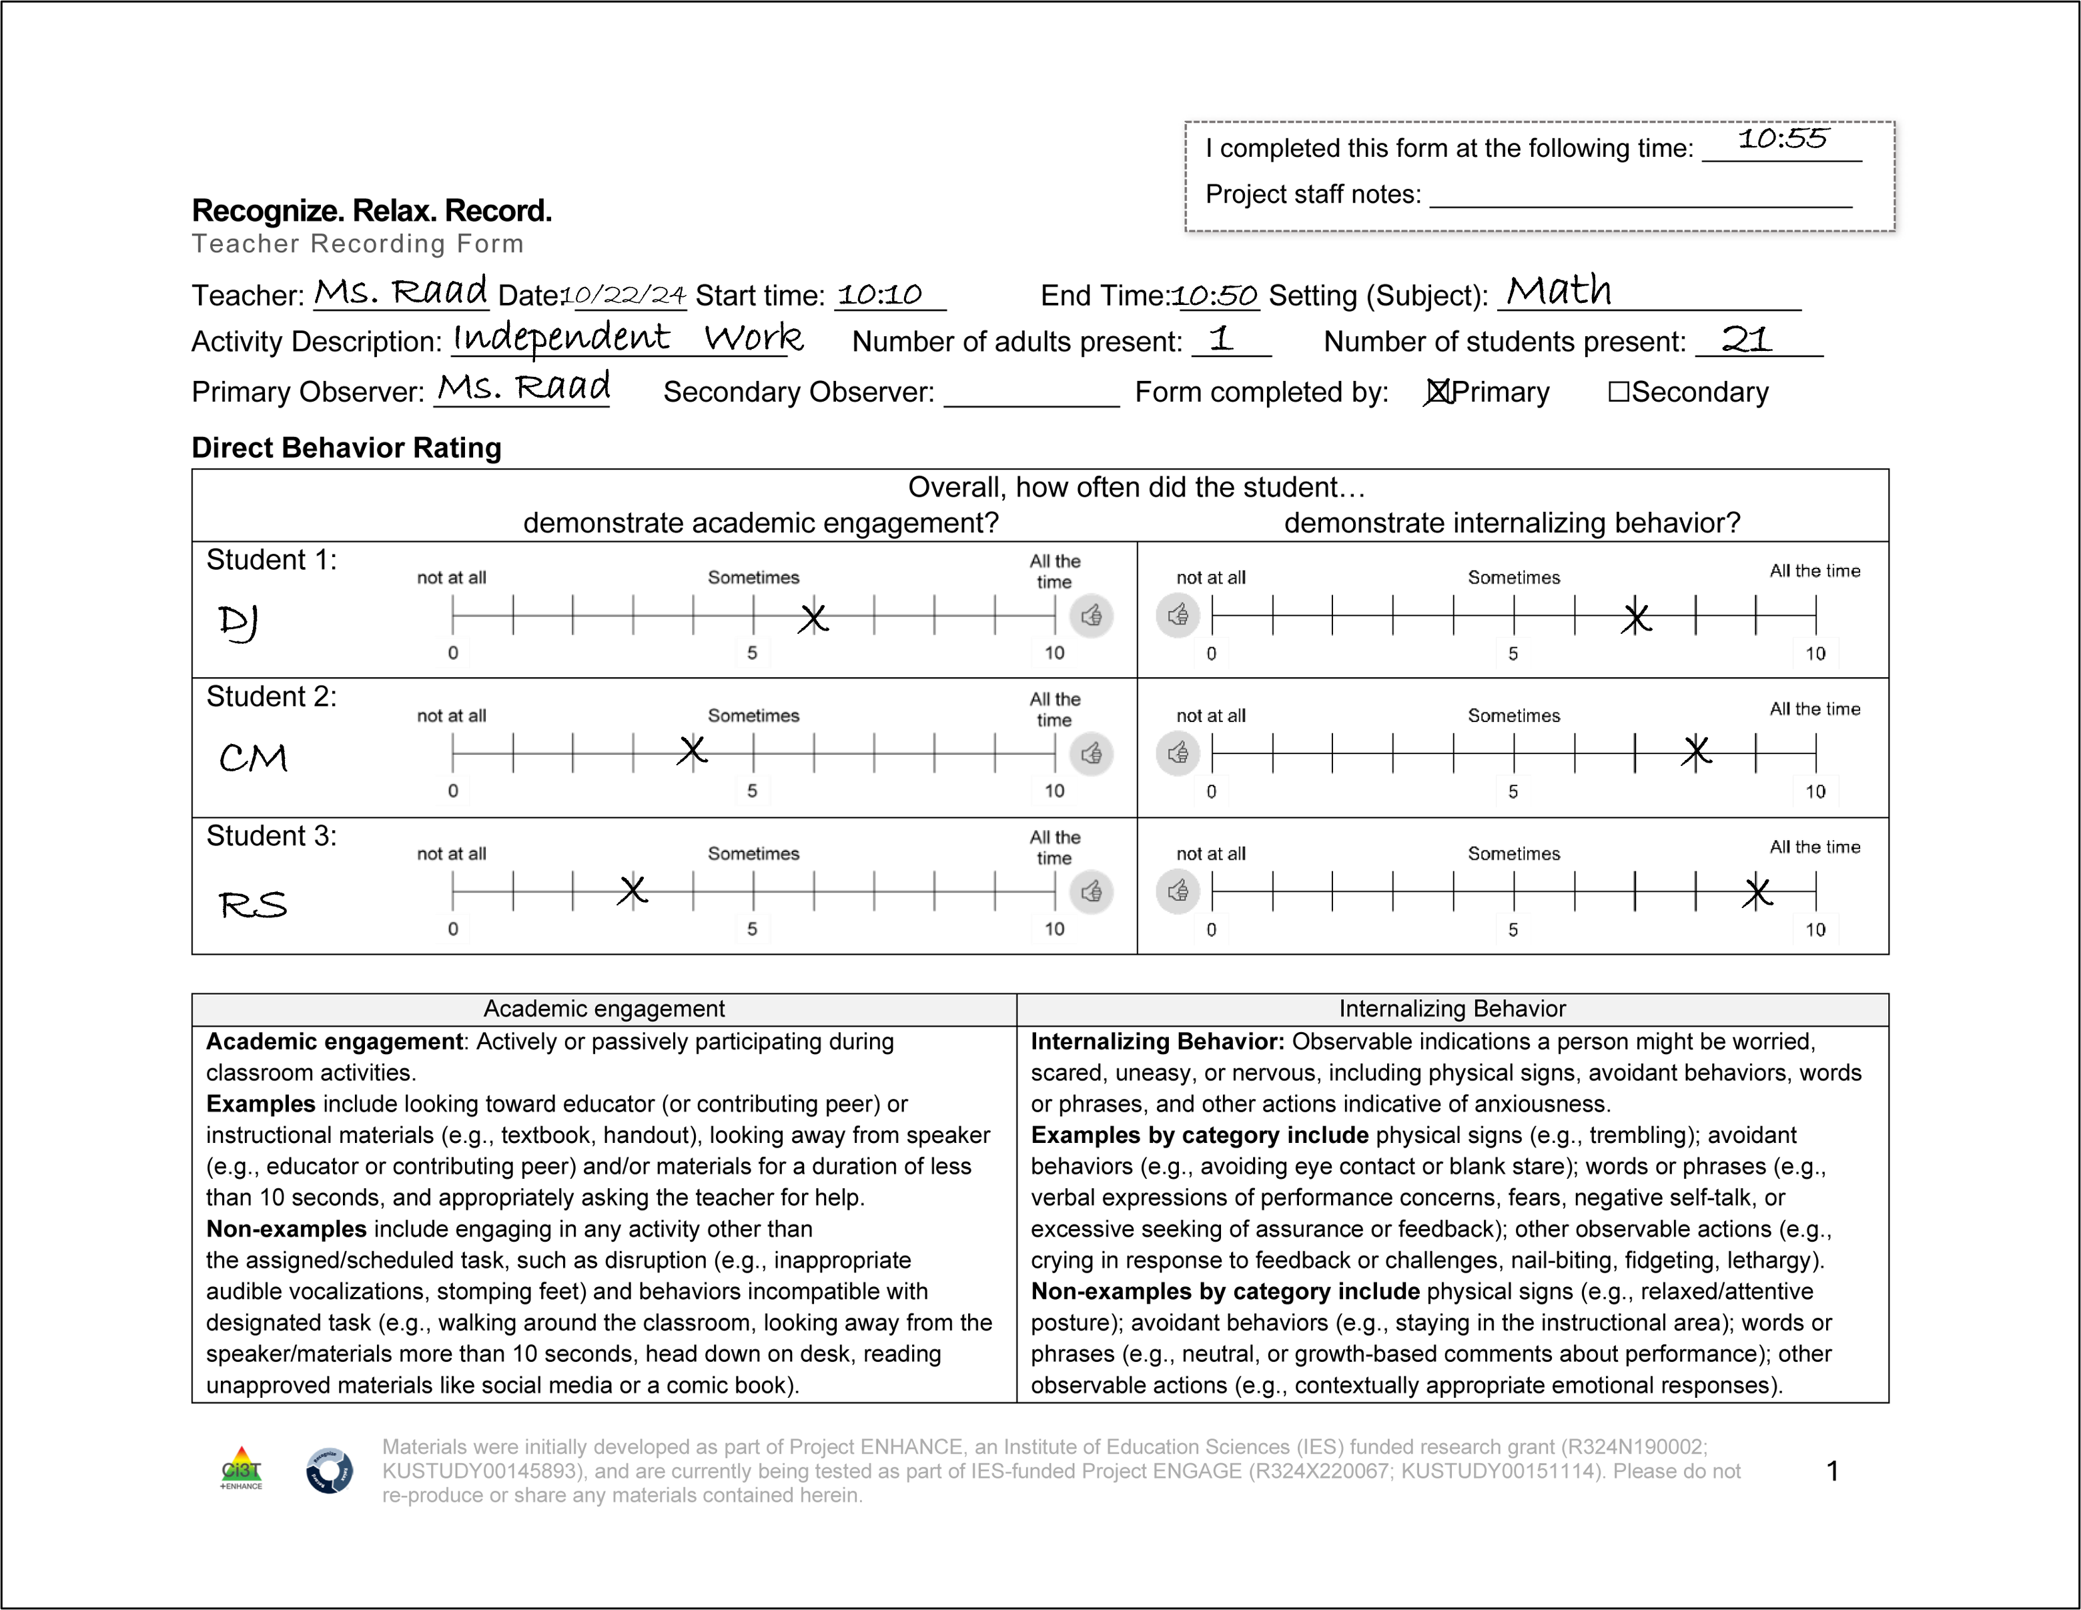
How is DBR used in this intervention?
DBR data are collected during the RRR Rating Period a 40-minute instructional block during which students would most benefit from using their new strategies to increase engagement and regulate anxious feelings
Later in the intervention (during RRR In-Class), students will self-monitor their own behavior during this time
Teachers will collect DBR data throughout all stages of intervention:
Baseline (~6-8 days)
RRR Instruction
RRR In-Class

Slide 40
Teacher Recording Form
DBR data are collected using the Recognize.Relax.Record Teacher Recording Form to measure students’:
Academic engagement
Internalizing behavior

Slide 41
Operational Definition: Academic Engagement

Slide 42
Operational Definition: Internalizing Behavior

Slide 43
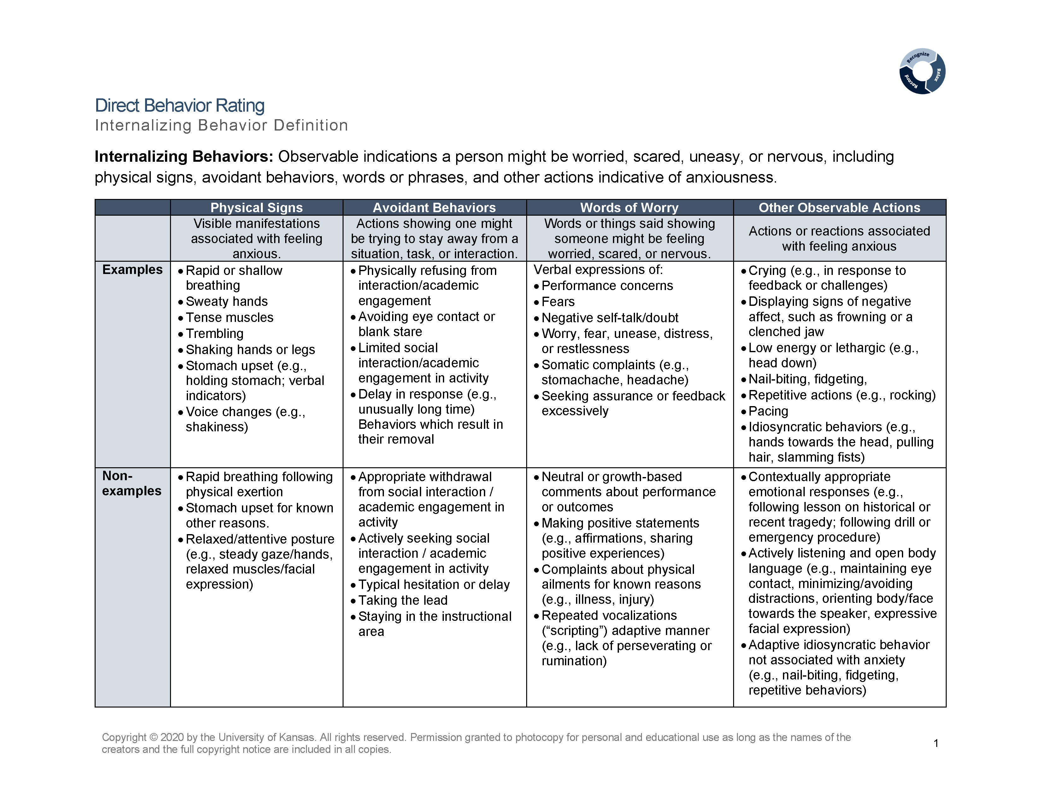
Direct Behavior Rating: Internalizing Behavior Definition

Slide 44
DBR Procedures: RRR Rating Period
Plan to collect DBR data four times a week
Generally, Monday through Thursday
At the end of the RRR Rating Period, complete the Teacher Recording Form

Slide 45
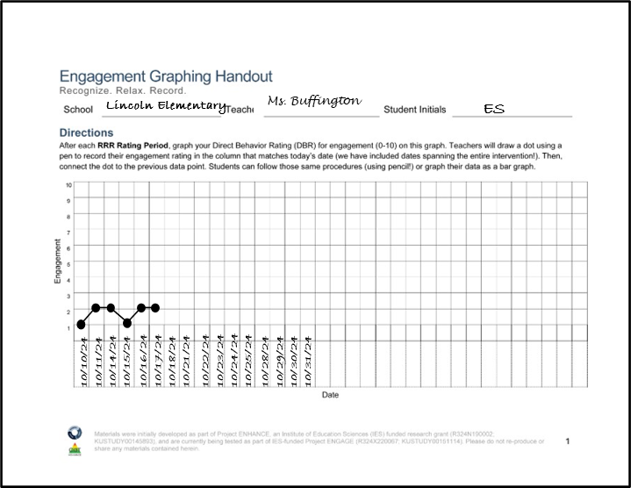
RRR Engagement Graphing Procedures
Each student will have their own Engagement Graphing Handout
Later in the intervention (during RRR In-Class), students will also add their total engagement ratings to this graph!
Once you have completed the Teacher Recording Form, graph each student’s overall engagement score on their graph

Slide 46


Talk Time
What does internalizing behavior look like for your students?
What time of day might work best for your RRR Rating Period?
Notes:
2-minute timer

Slide 47
Step 4
Provide RRR Instruction

Slide 48
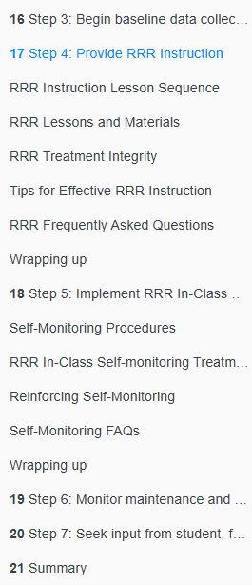
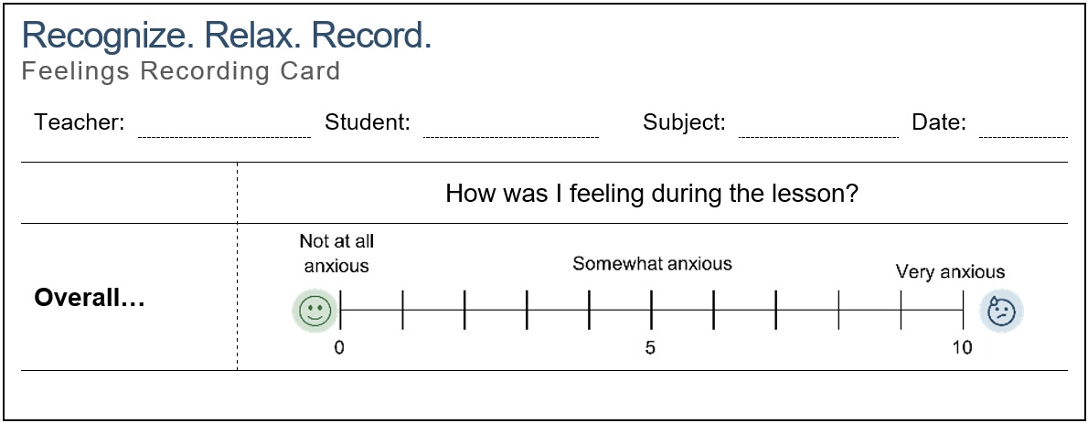
RRR Module Highlight!
RRR Module Highlight 3

Slide 49

Step 4 Provide RRR Instruction

Slide 50
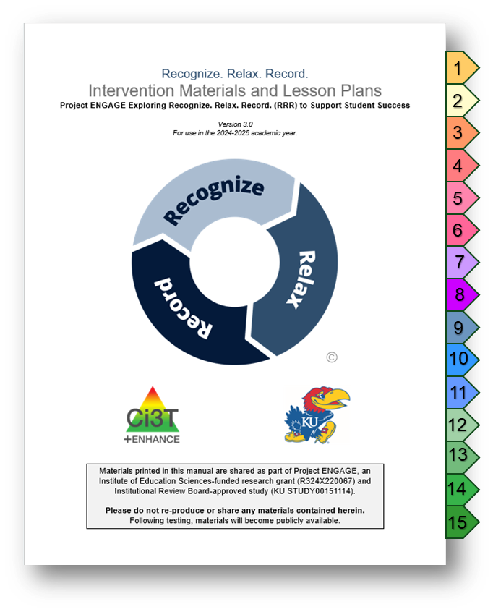
Lesson Plans Overview
15 lessons available
Recognize - 3 lessons
Relax - 8 lessons*
Record - 2 lessons
Ready-Go!
Review (optional)
20-30 min each lesson
Semi-scripted
Teacher-led

Slide 51
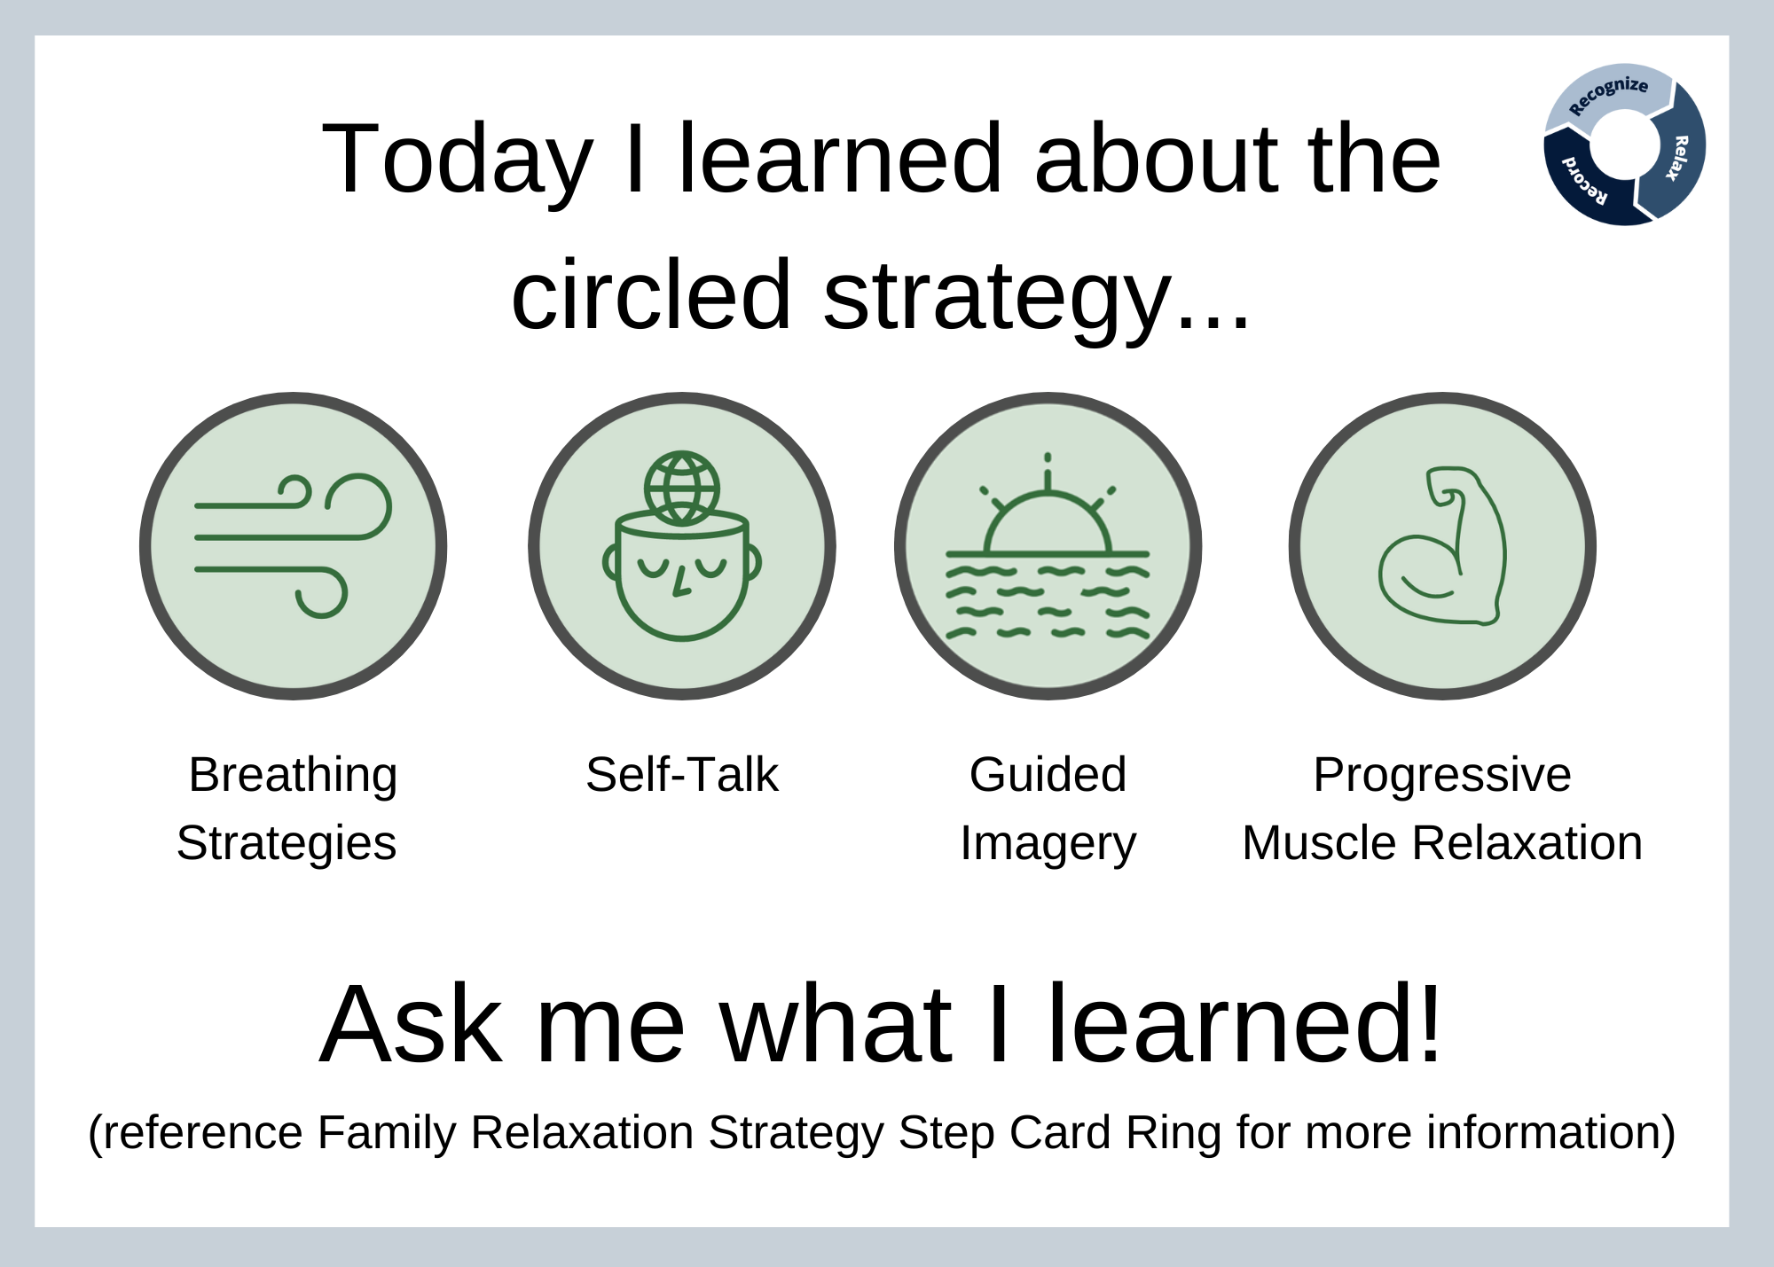
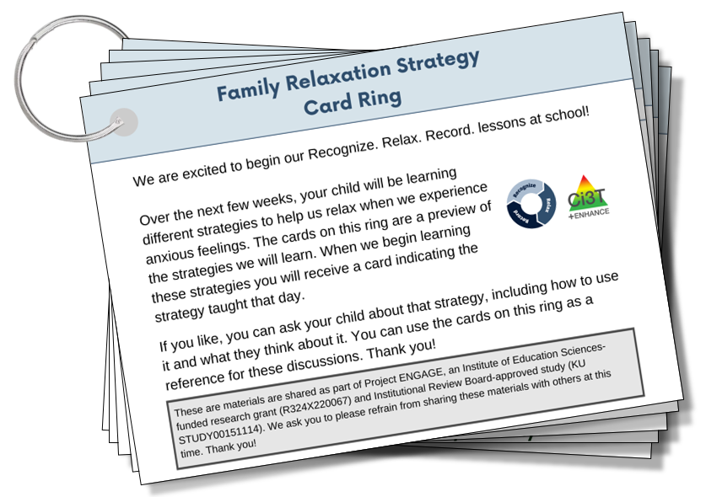
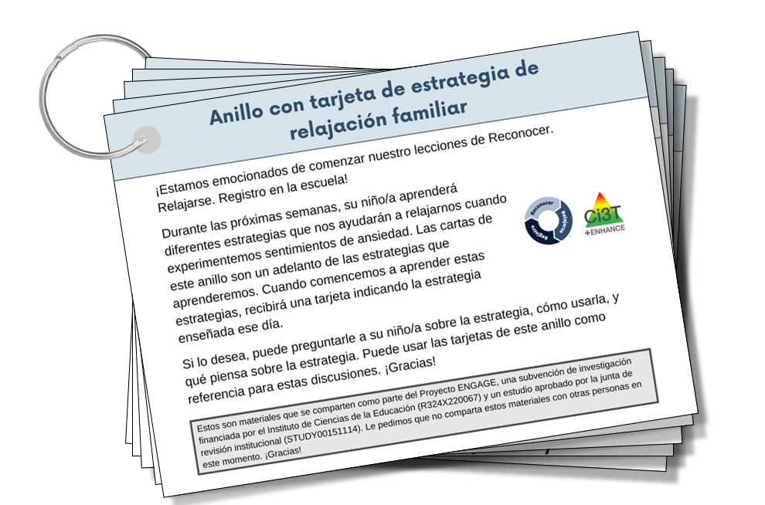
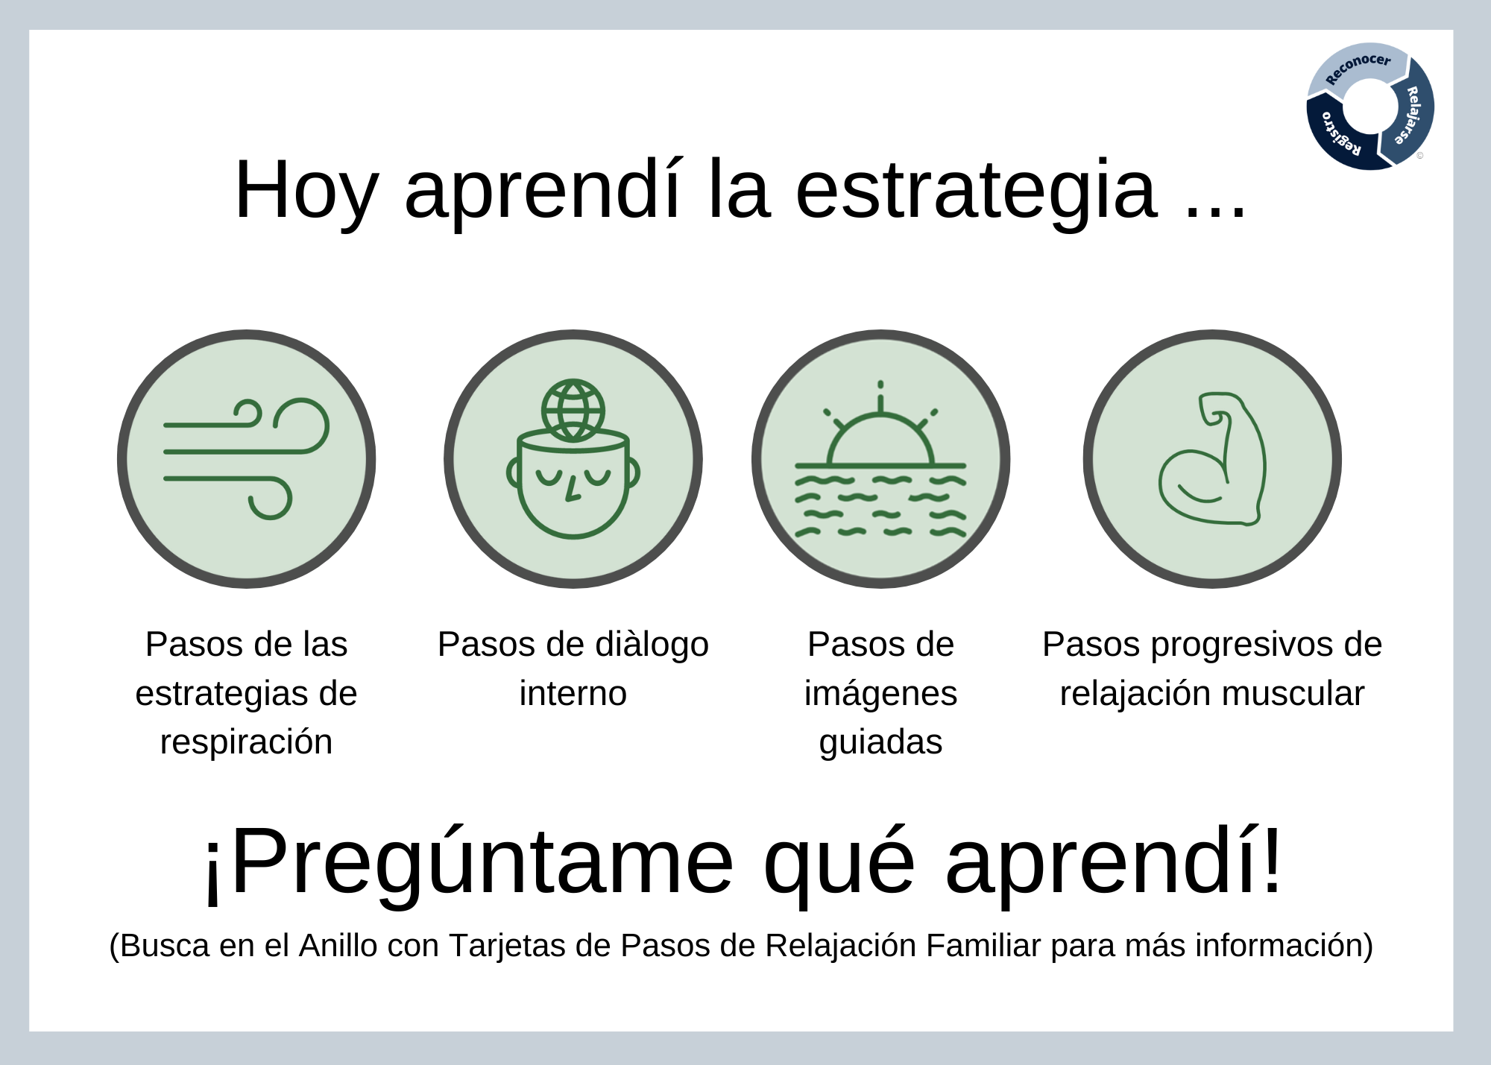
Family Materials
Available in both Spanish and English!

Slide 52
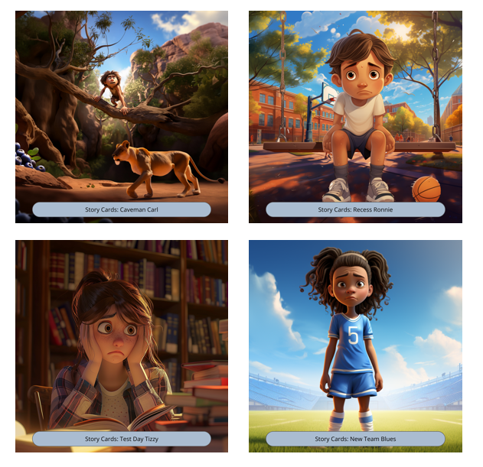
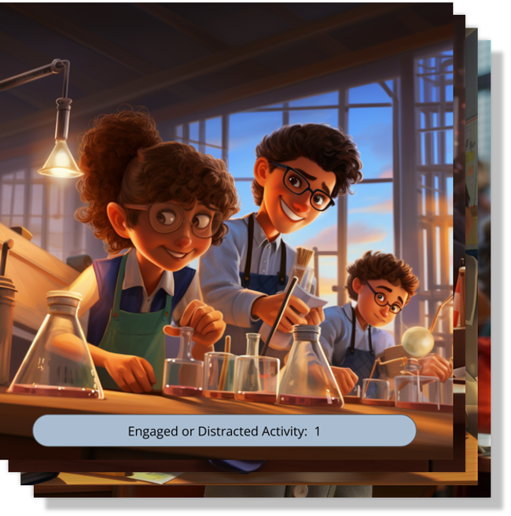
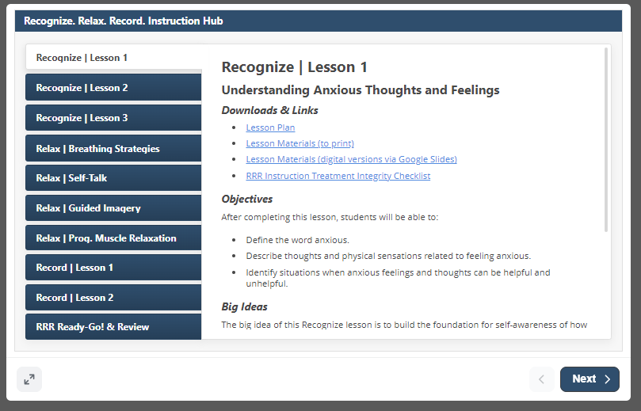
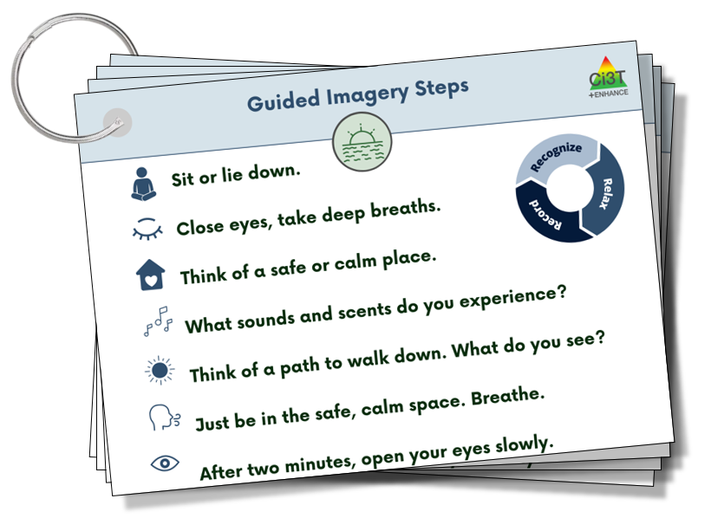
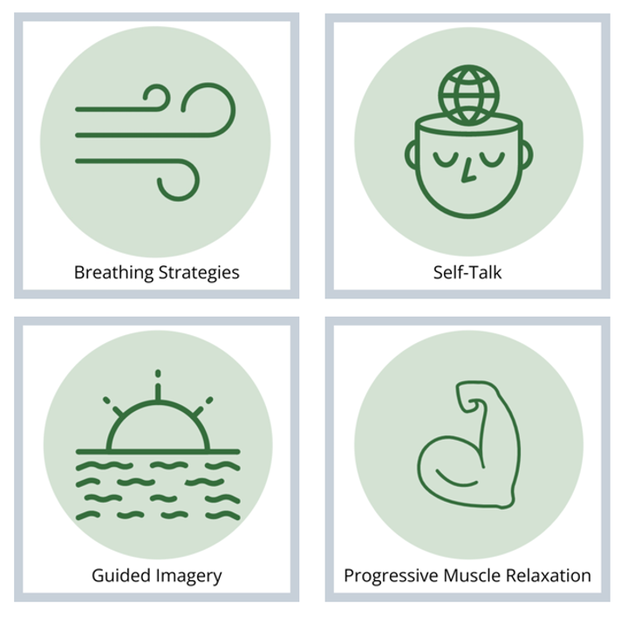

Teacher Materials

Slide 53


Key Intervention Lesson Features
Big Idea
Suggested Pacing & Prompts
Embedded Materials
Situational Stories
Activities
Semi-scripted & predictable layout

Slide 54

RRR Ready-Go!
Final lesson in sequence
Lesson taught after students have had a few days of RRR In-Class
Flexible lesson to review:
Self-Monitoring Sheet
Engagement Graphing Handout

Slide 55


Optional Review Lesson
Optional customizable lesson to use as needed following an extended break in instruction.

Slide 56
Step 5
Implement RRR In-Class and Monitor Student Performance

Slide 57


RRR Module Highlight!
RRR Module Highlight 4

Slide 58

Step 5 Implement RRR In-Class and Monitor Student Performance
Step 5 Implement RRR In-Class and Monitor Student Performance 1

Slide 59

Self-Monitoring Treatment Integrity Checklist
Self-Monitoring Treatment Integrity Checklist located on the back of the RRR Rating Form
Completed daily at end of RRR In-Class Period
rate all procedures on a scale from 0 (not implemented) to 3 (fully implemented)
each procedure is rated for each student

Slide 60
Step 6
Monitor maintenance and generalization

Slide 61


Step 6 Monitor maintenance and generalization

Slide 62
Step 7
Seek input from student, families, and teachers

Slide 63


RRR Module Highlight!
RRR Module Highlight 5

Slide 64


Step 7: Seek input from student, families, and teachers

Slide 65
Social Validity Interviews …
Social Validity Interviews 1
From Teachers … Group 1
“Literally saw a shift in body language after lessons.”
“I wish everyone put together lessons like you guys did. It was so well put together.”
“At first I thought it was going to be a lot of work, but it worked seamlessly into our routine.”
“Boys wanted to talk about their graphs and how they improved.”
“You came and changed my life.”
From Teachers … Group 2
“Instead of internalizing she was able to verbalize her feelings more and talk about things that have happened at home. She has gained confidence in expressing her feelings.”
“In this school we have a lot of trauma and students struggling. I think kids with anxiety are often overlooked-they have a need and now we have something to do for them for the first time.”
“I don’t always feel like I know students well that don’t have big behaviors. It was good for me to get to know them a little better.”
“This program had done wonders for this student in a short amount of time.”

Slide 66
Social Validity Interviews …
Social Validity Interviews 2
From Students
“I got really mad at home and did some breathing.”
“It definitely made me improve on a bunch of stuff. Helped with my self-control.”
“Helped when I couldn’t sleep at night.”
“When I am frustrated, it helps me remember to take a breath.”
“This would help my friends in math say, “I can do this”.”
“When my brother makes me mad, I take deep breaths and visualize being somewhere calm.”

Slide 67
Wrapping Up and Moving Forward

Slide 68
Knowledge, Application, Impact Points
Knowledge, Application, Impact Points 2
If you are in Kansas, you can earn 2 x PD points for application and 3 x for impact!
We are happy to review your materials before you upload!

Slide 69

Project EMPOWER+
EMPOWER+ Session | Date
Starting Strong: Effective Tier 1 Practices for Educators | September 24, 2025 (Wednesday)
From Data to Action: Using Systematic Screening to Inform Instruction | October 8, 2025 (Wednesday)
Ci3T In Action: Integrated Lesson Planning for Enhanced Instruction | November 18, 2025 (Tuesday)
Mastering Behavior Specific Praise and Precorrection | January 21, 2026 (Wednesday)
A 6-Step Instructional Approach for Responding to Challenging Behaviors: A Tier 1 Practice | February 10, 2026 (Tuesday)
A Tier 2 Support for Students Experiencing Anxious Feelings: Recognize. Relax. Record. | March 25, 2026 (Wednesday)
A Tier 3 Support for Students with Intensive Intervention Needs: Functional Assessment-Based Intervention (FABI) | April 28, 2026 (Tuesday)

Slide 70



Thank you!
Thank you!
ci3t.org
#Ci3T
@Ci3Tmodel
Tag us in your Ci3T highlights, we love to see Ci3T in action!
Follow us on Instagram for updates and new resources!
Notes:
Tag us in your Ci3T highlights- we would love to see Ci3T in action! Follow us on Instagram for updates and links to resources! @Ci3TModel
You will receive a brief session evaluation – we value your feedback and would greatly appreciate you taking a few minutes to share your thoughts on what you liked about the session and how we can improve

